Slide 1


Slide 2


Slide 3


Slide 4
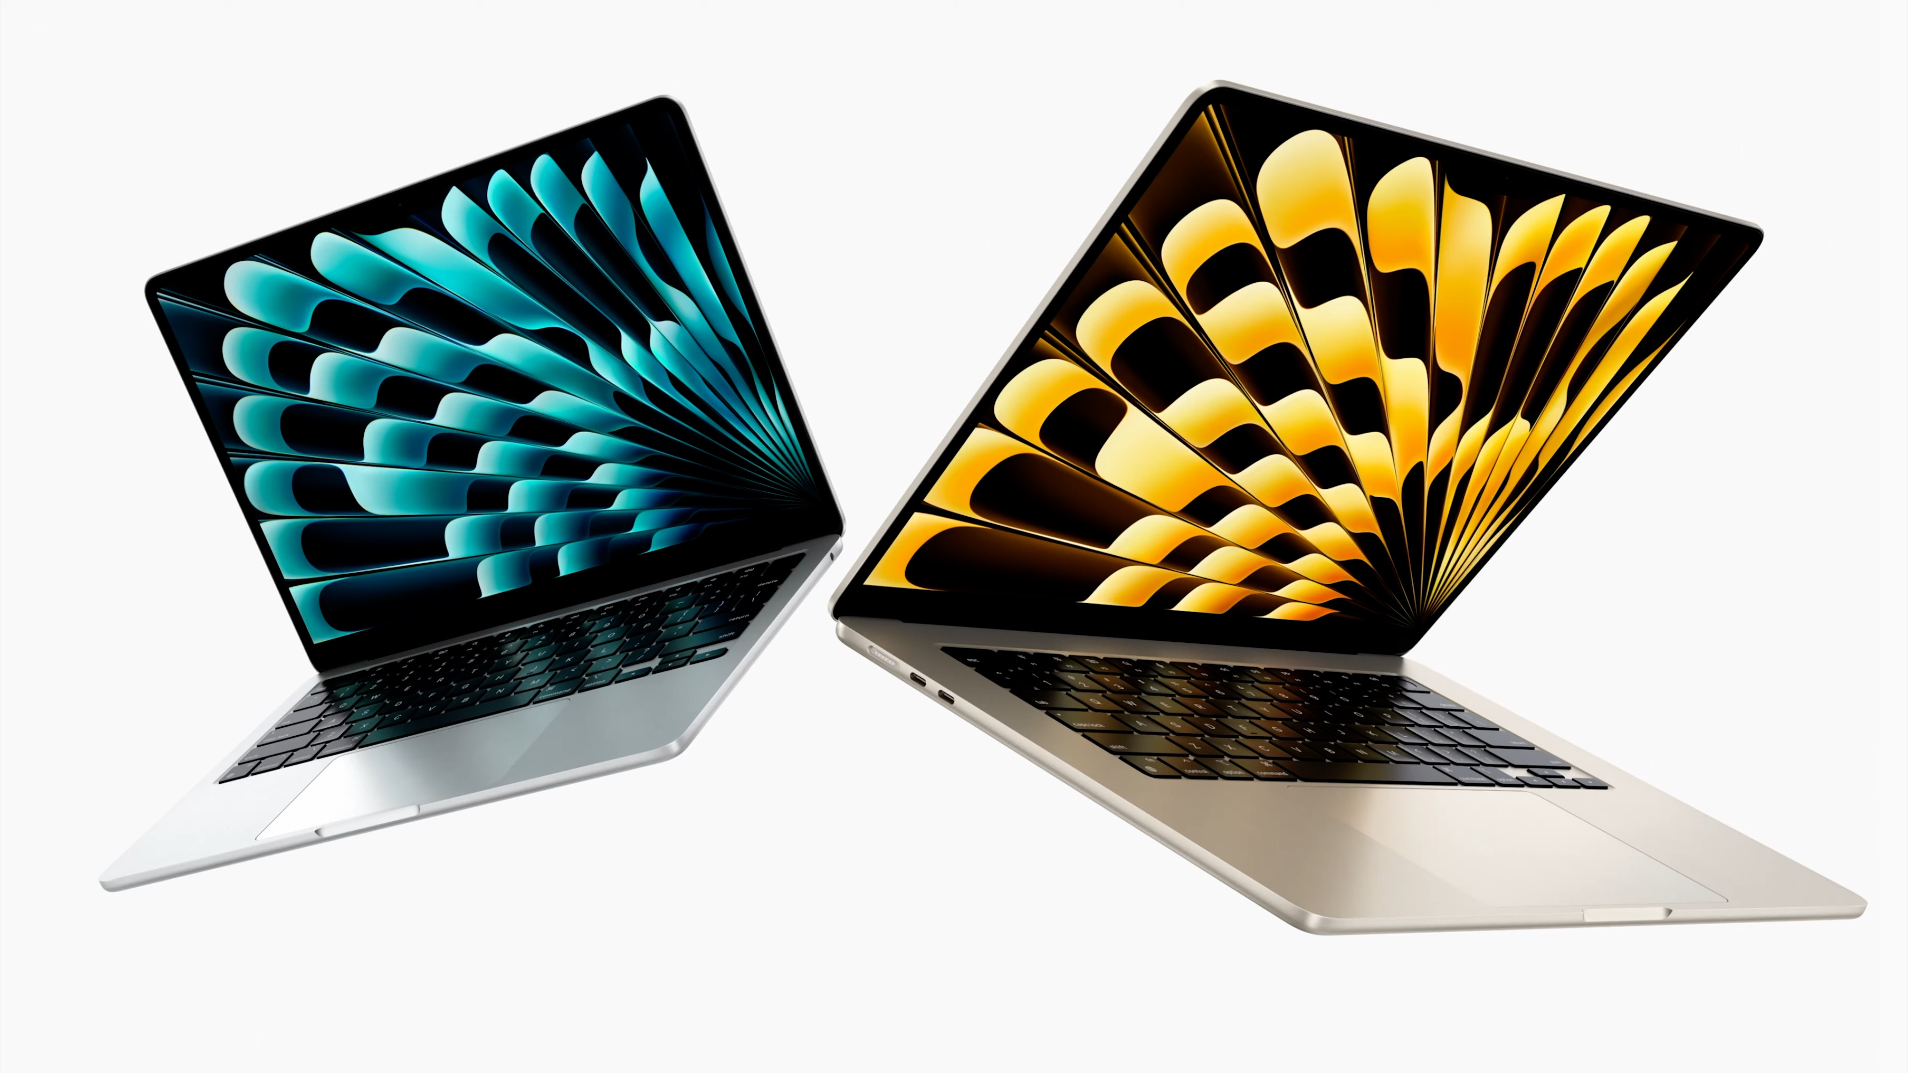

Slide 5
World‘s best-selling
13
- inch laptop
15

Slide 6


Slide 7


Slide 8


Slide 9


Slide 10


iPad

Slide 11
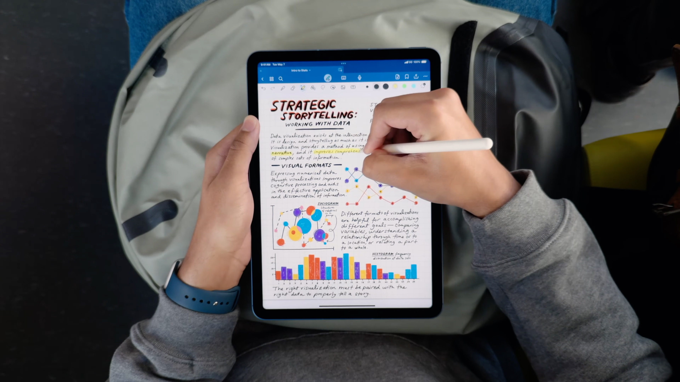

Slide 12


Slide 13
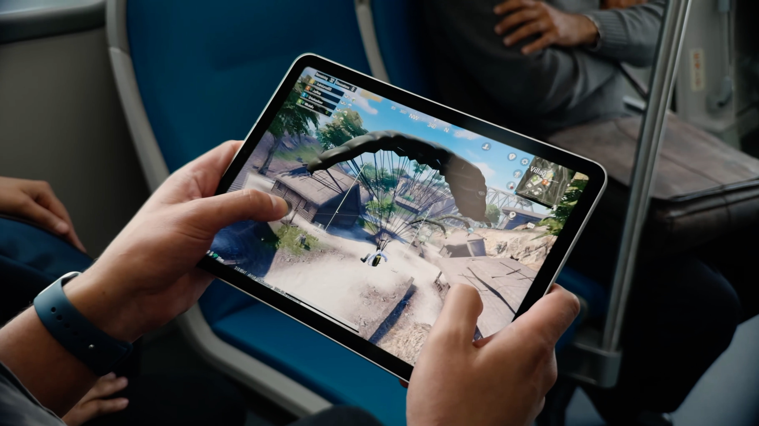

Slide 14
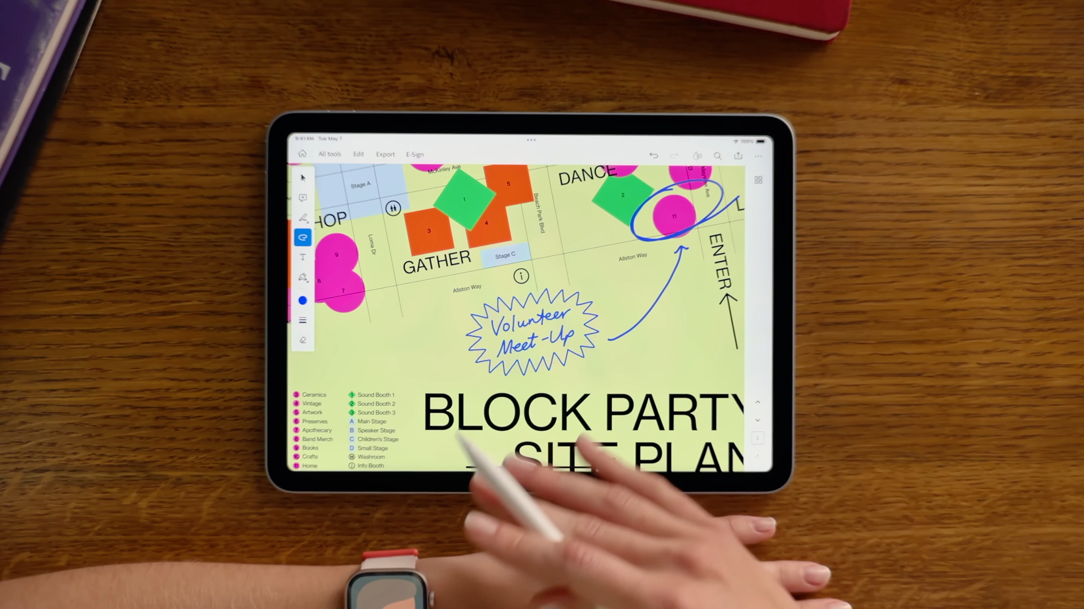

Slide 15
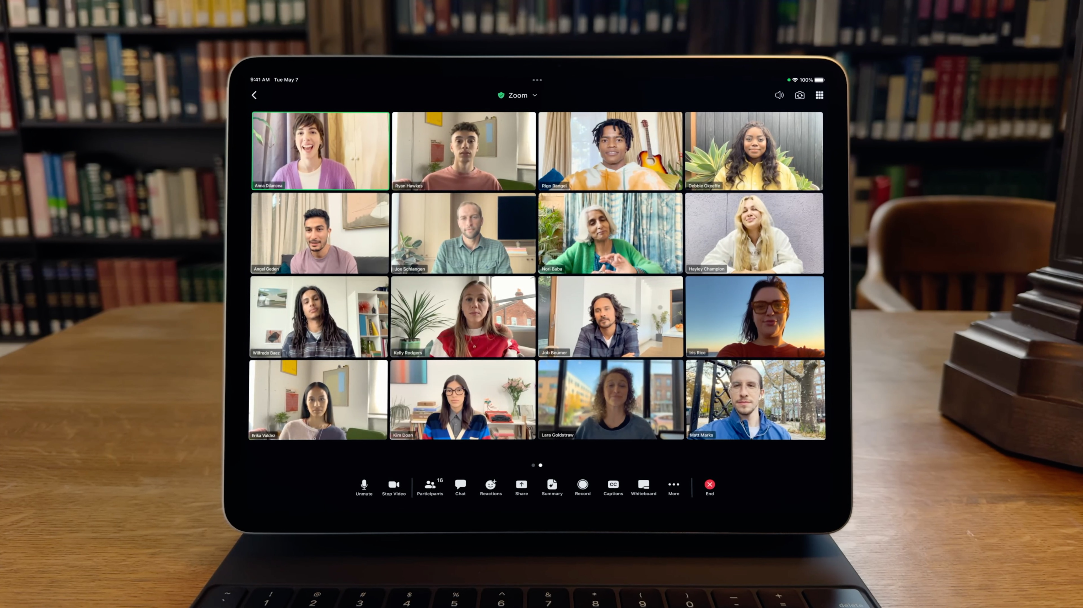

Slide 16
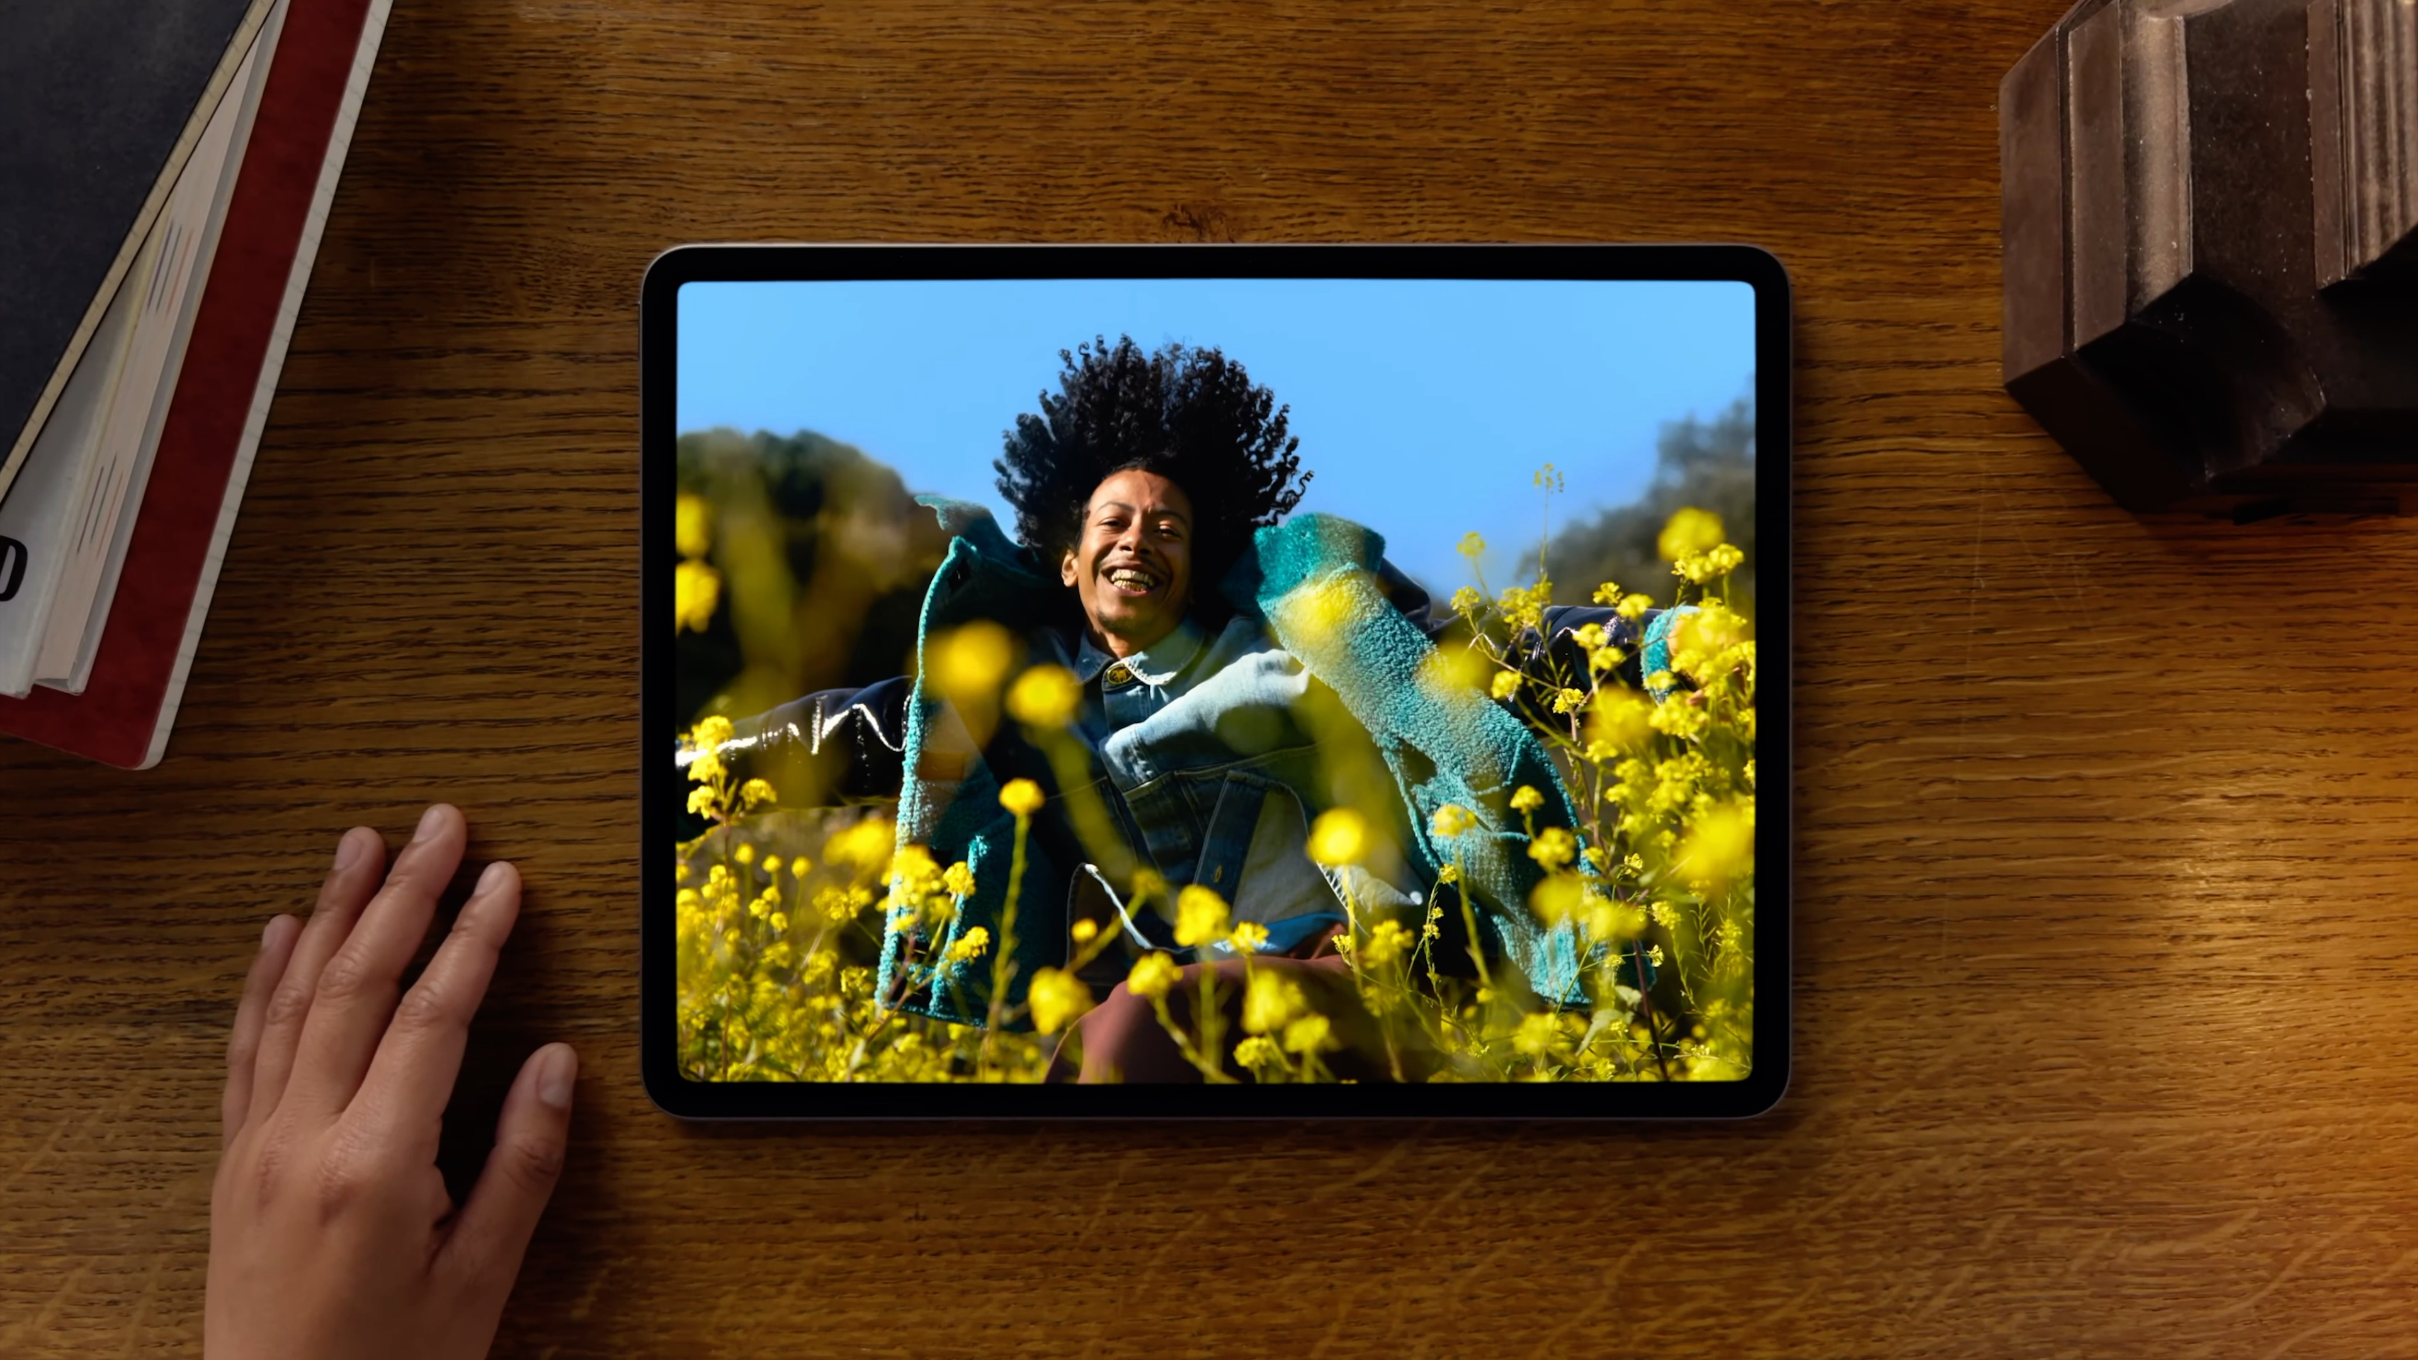

Slide 17
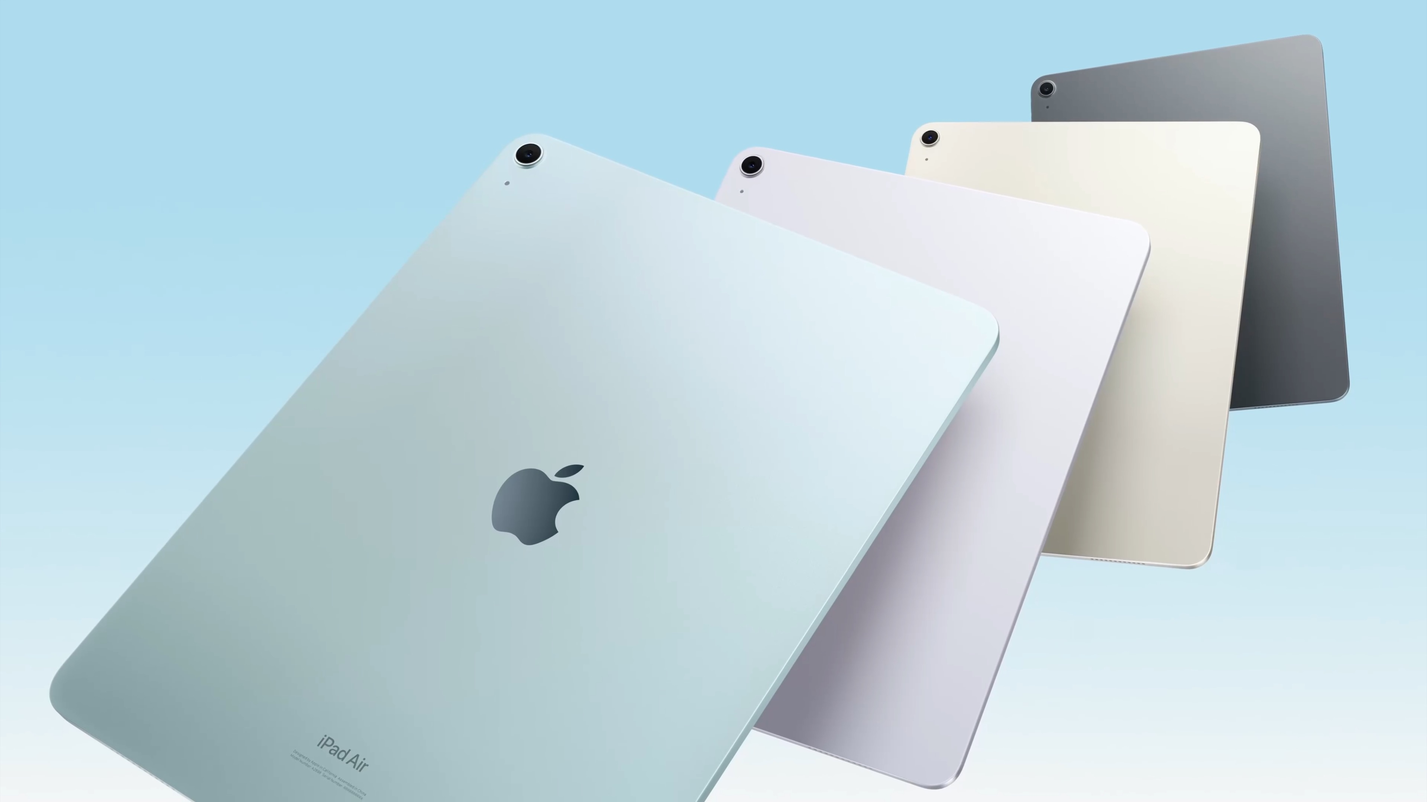

Slide 18



Slide 19
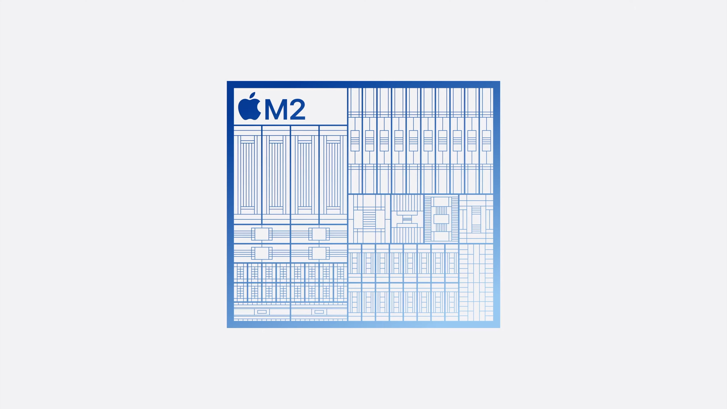
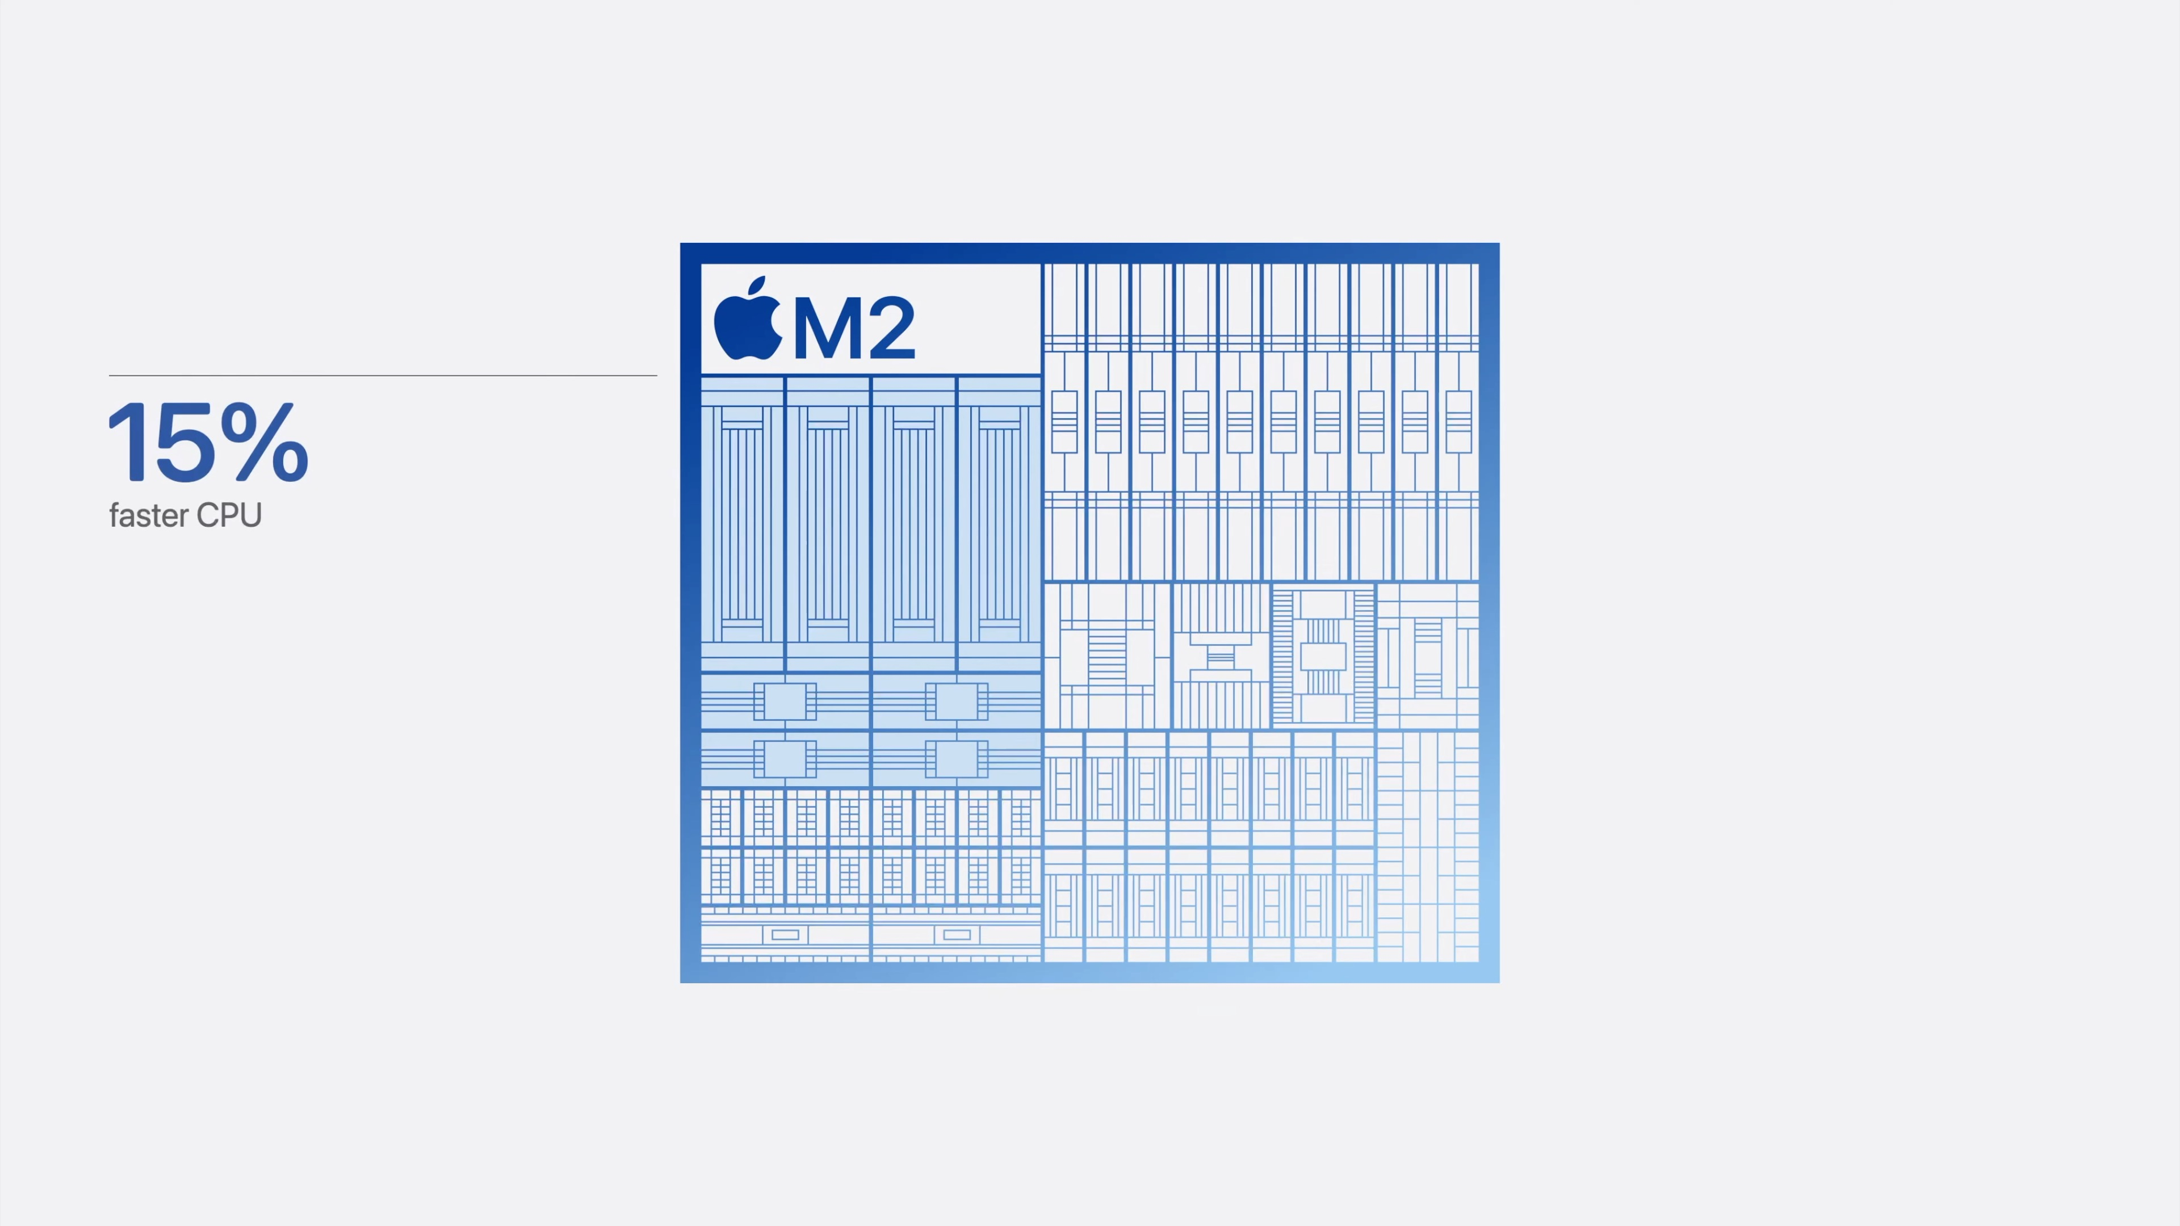
15%
faster CPU

Slide 20
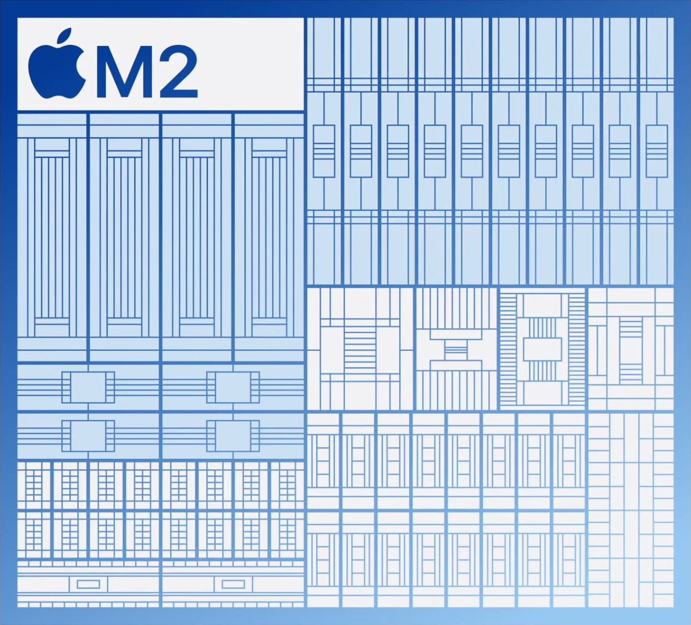
25%
15%
faster GPU
faster CPU

Slide 21
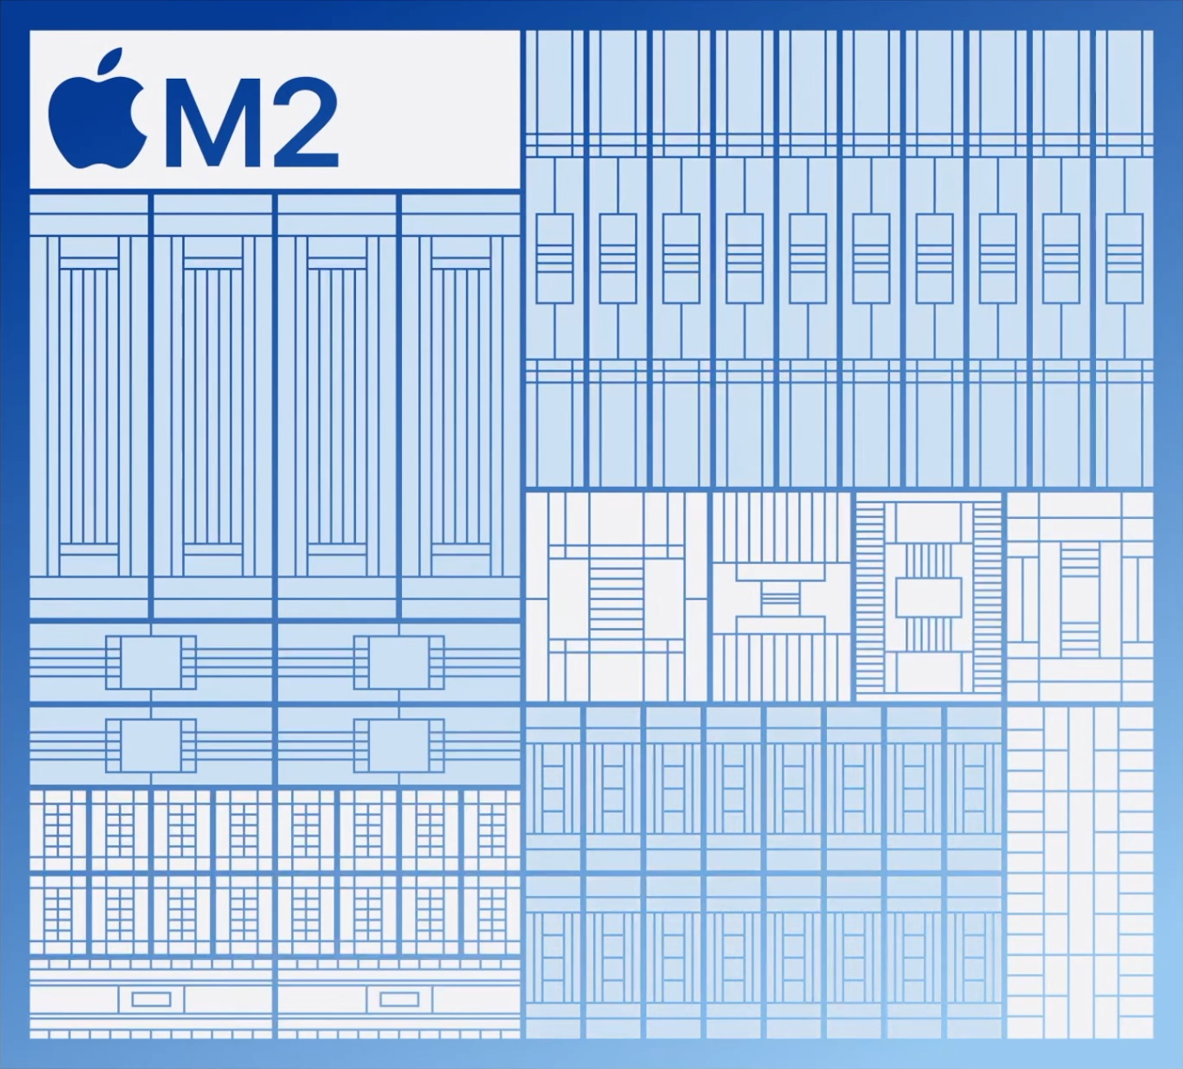
25%
15%
faster GPU
faster CPU
40%
faster Neural Engine

Slide 22
50%
Faster

Slide 23
3x
Faster performance

Slide 24
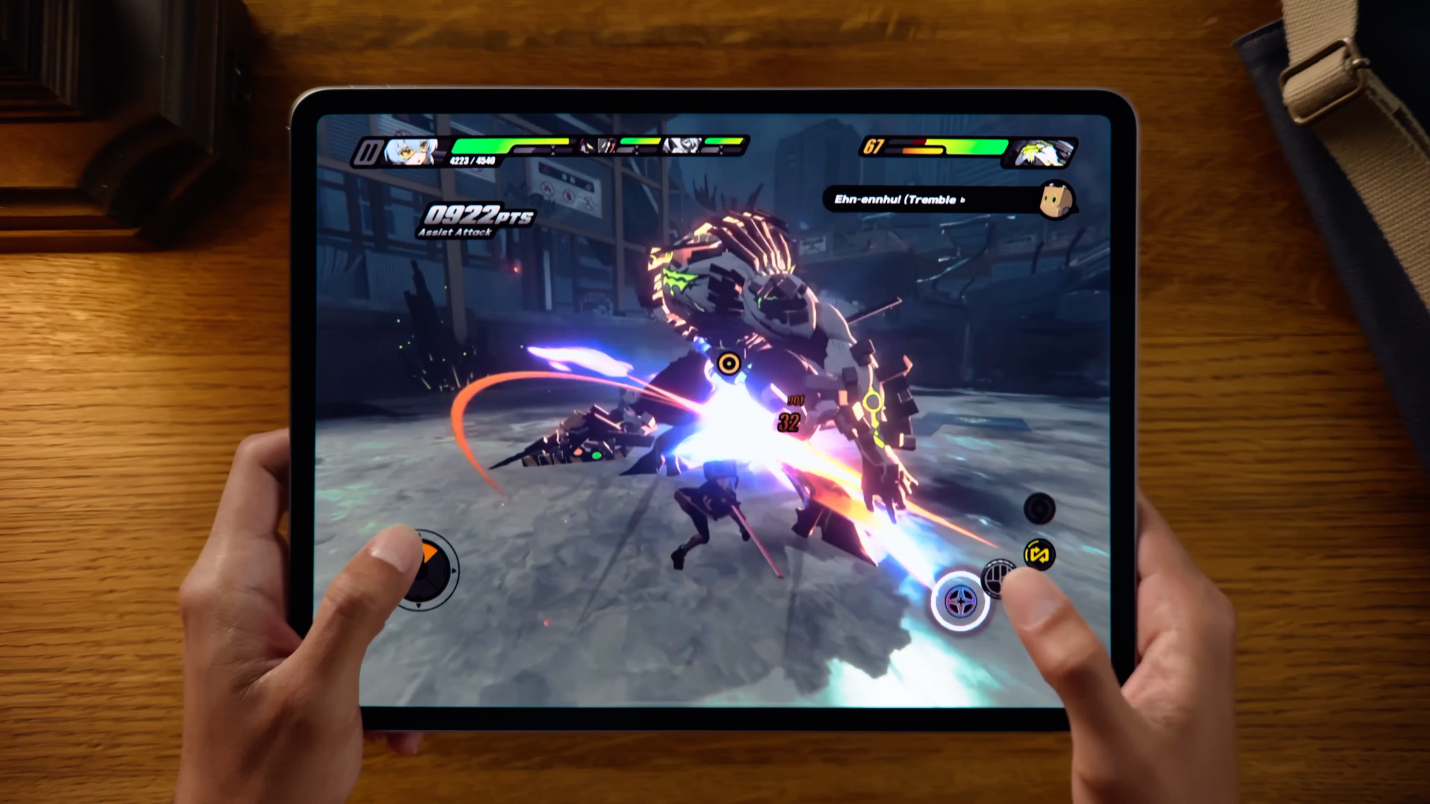

Slide 25
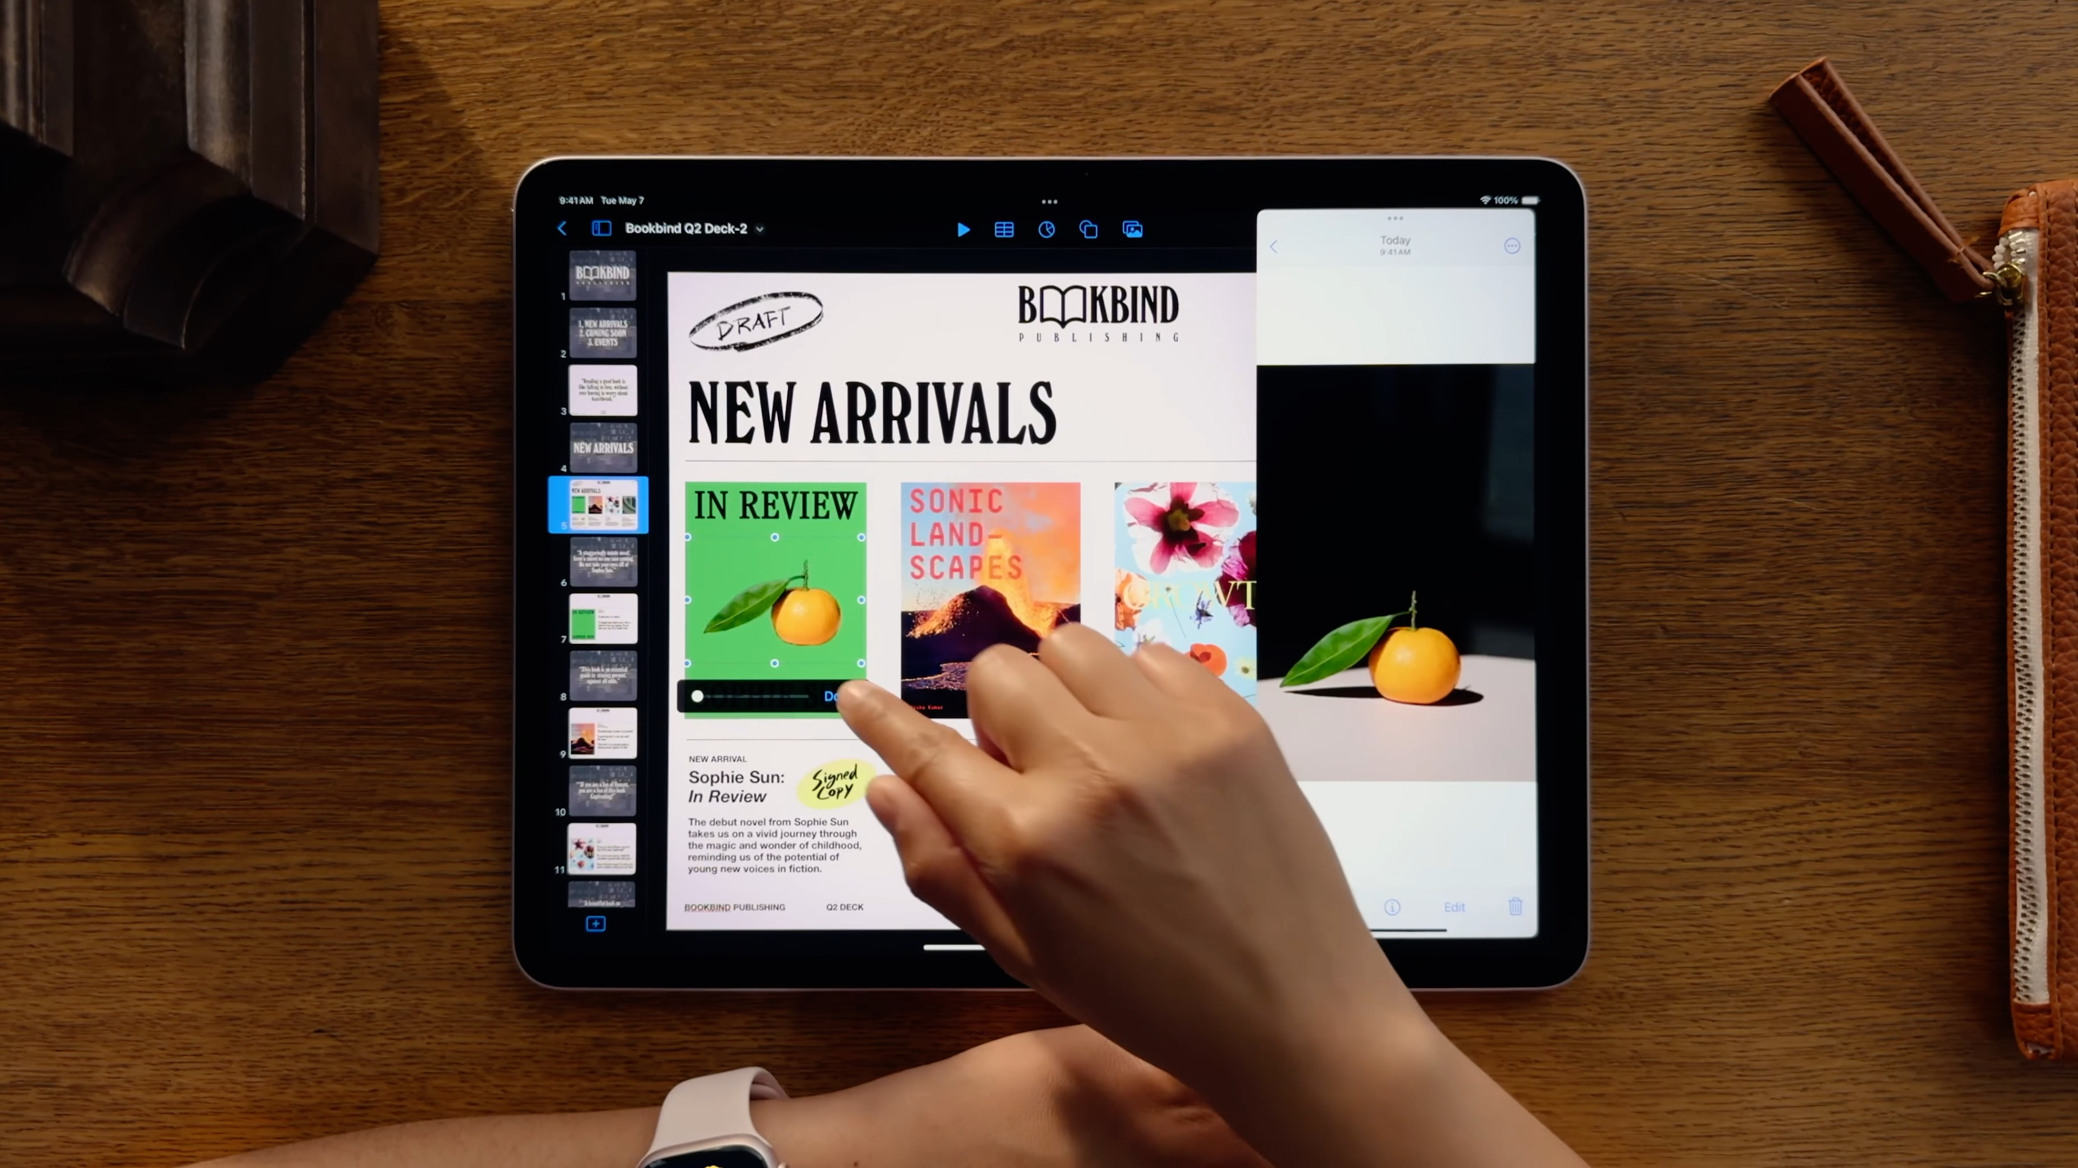

Slide 26


Slide 27
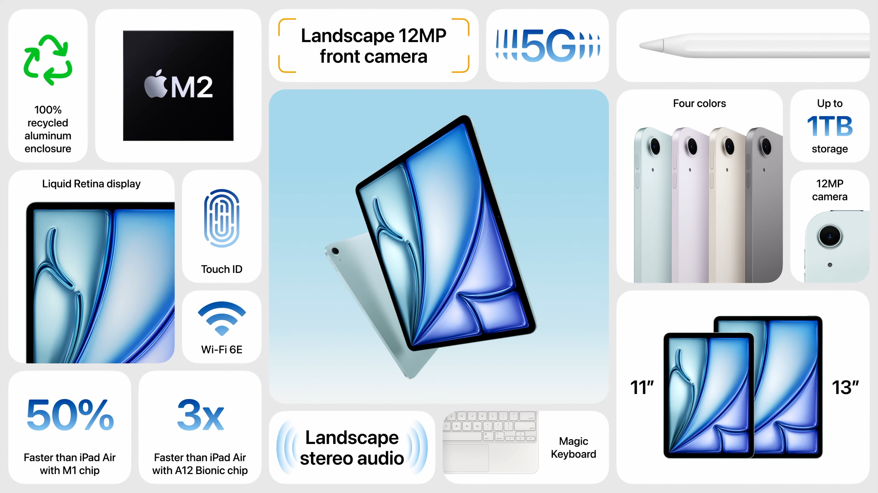

Slide 28



iPad
128GB

Slide 29
iPad
256GB
128GB
512GB
1TB

Slide 30
iPad
From
From
$599
$799
11-inch
11-inch

Slide 31
Order
Today

Slide 32
Available
Next week

Slide 33
iPad Pro

Slide 34


Slide 35


Slide 36
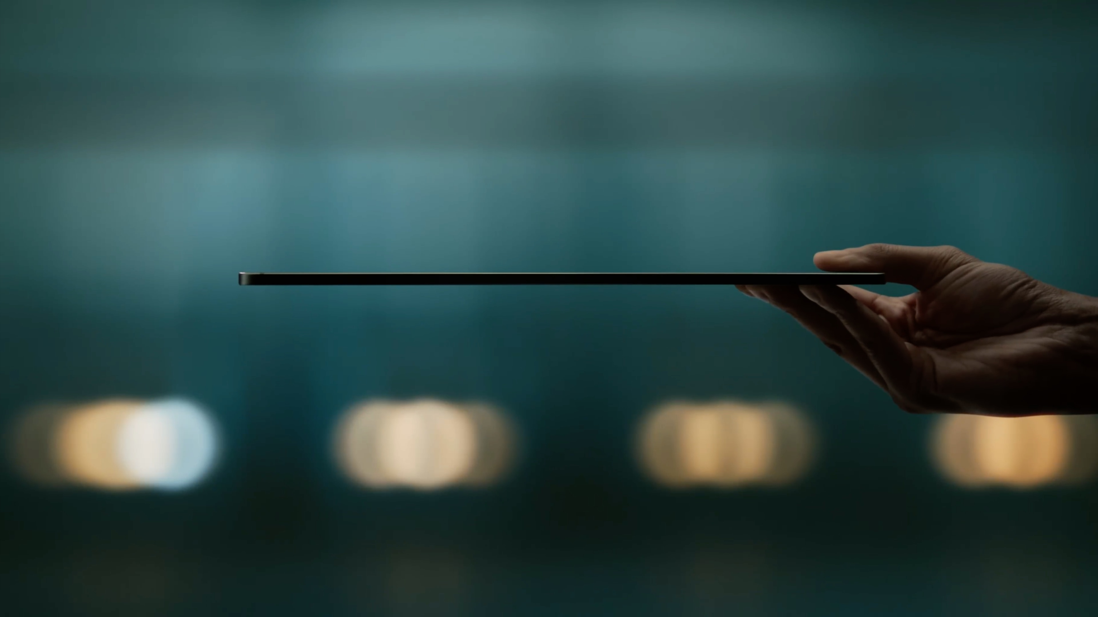

Slide 37
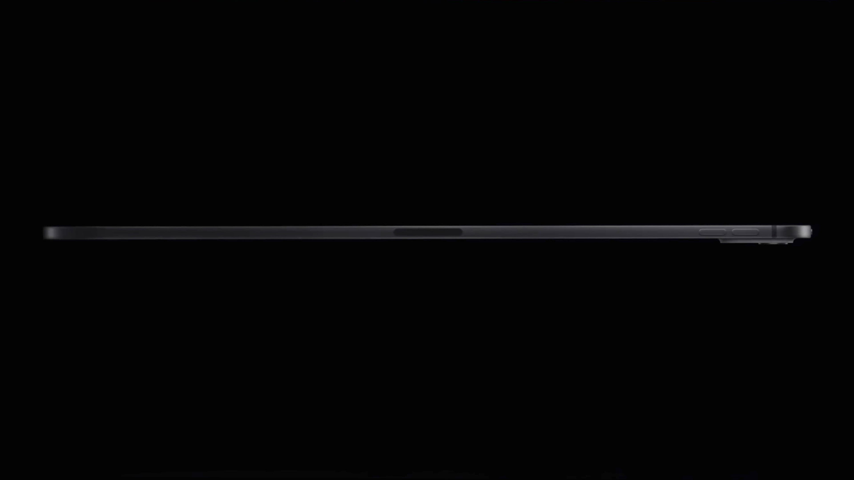

Slide 38
Stunning design
Breakthrough display
Outrageous performance
Amazing accessories

Slide 39
Stunning design
Breakthrough display
Outrageous performance
Amazing accessories

Slide 40
Stunning design
Breakthrough display
Outrageous performance
Amazing accessories

Slide 41
Stunning design
Breakthrough display
Outrageous performance
Amazing accessories

Slide 42
Design

Slide 43


Slide 44
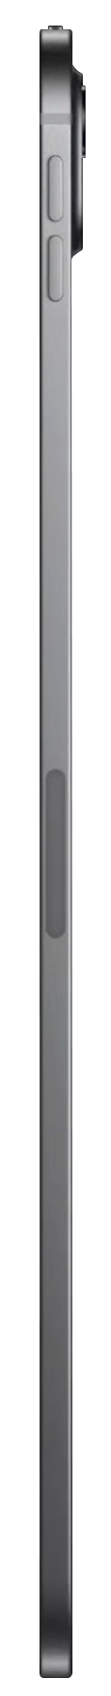

Slide 45
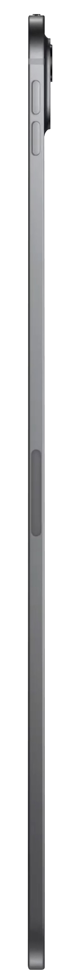
5.3 mm
5.1 mm

Slide 46
5.1 mm

Slide 47
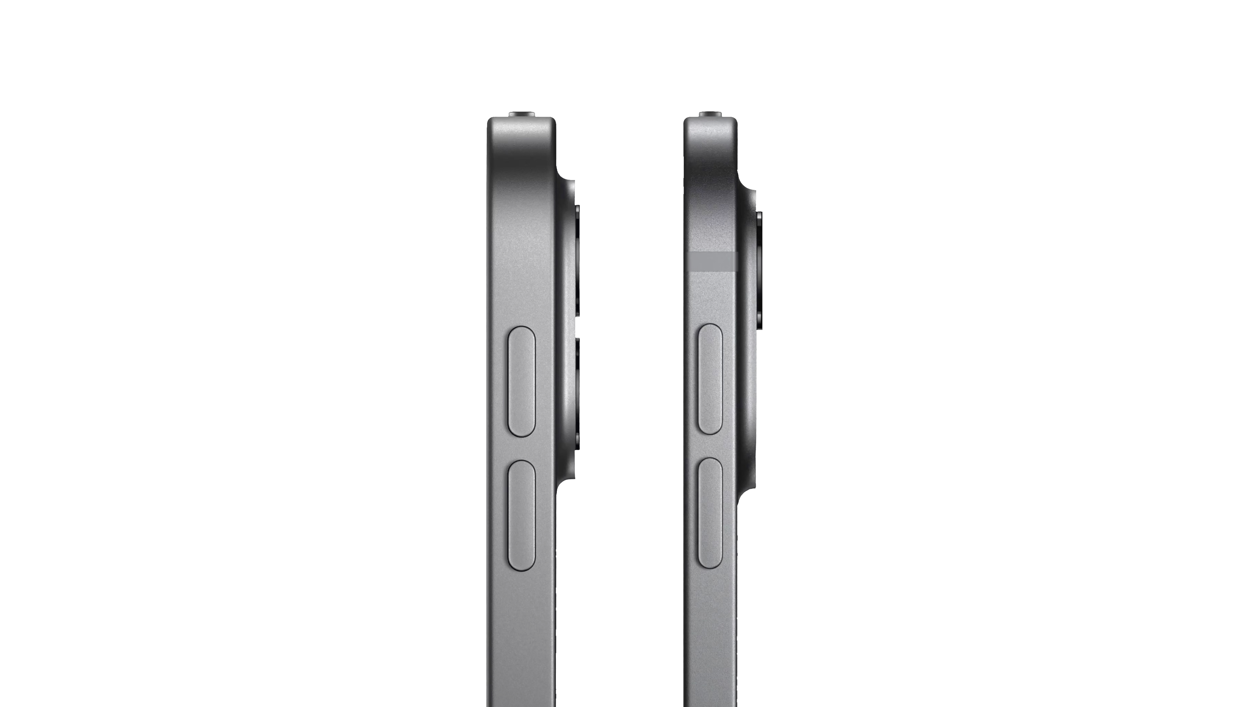

Slide 49
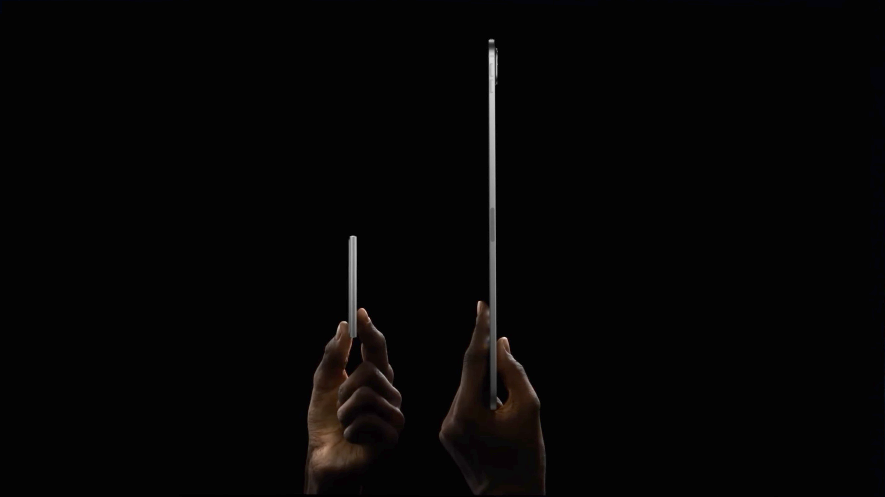

Slide 50
Thinnest Apple product ever

Slide 51
0.98 lb.

Slide 52
0.98 lb.
1.28 lb.

Slide 53
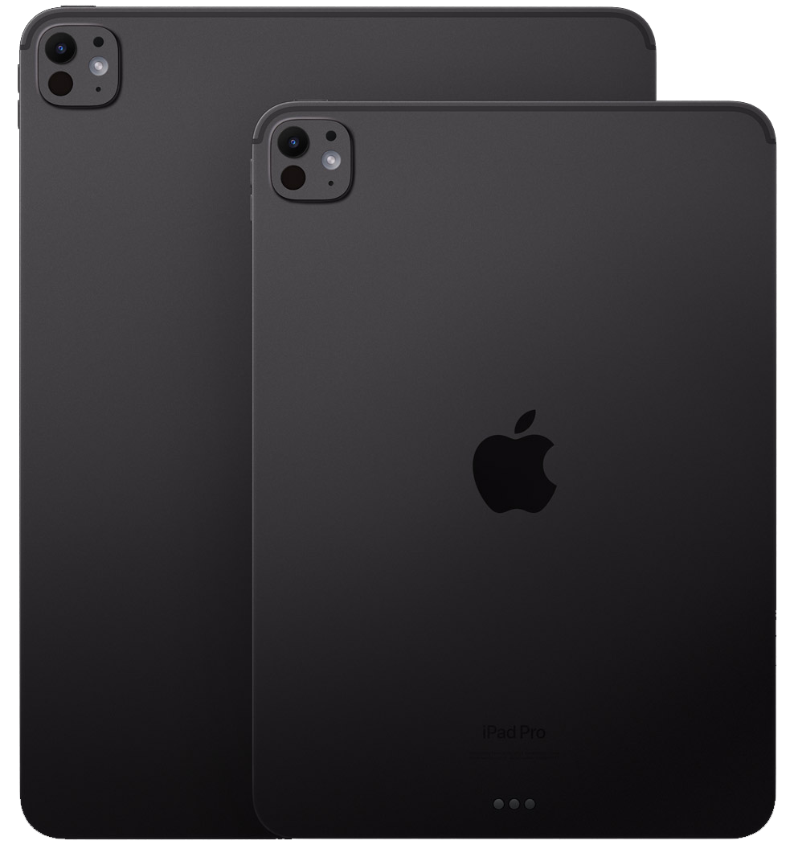

Slide 54
Display

Slide 55
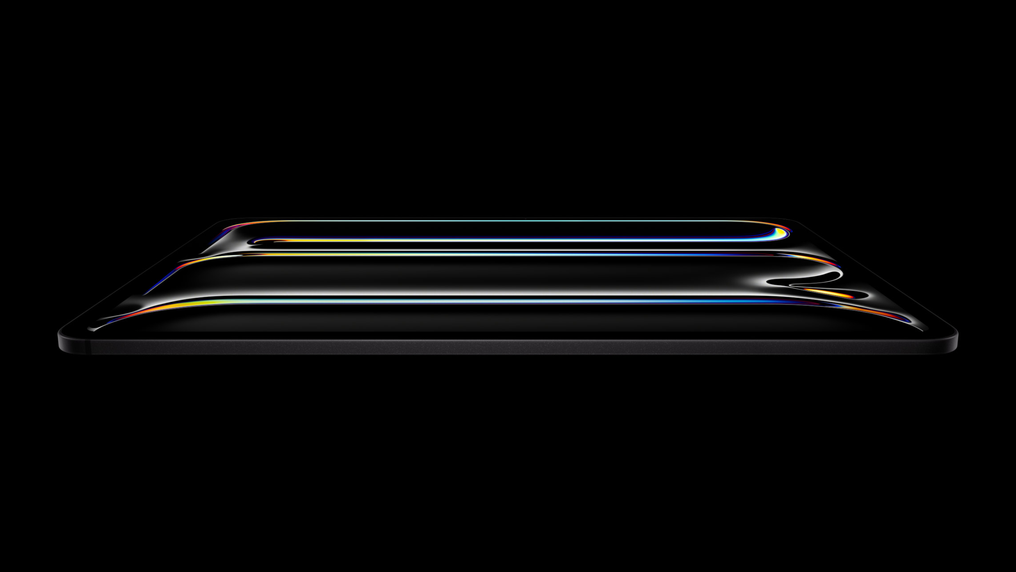

Slide 56
Tandem OLED

Slide 57
1000 nits
Full-screen brightness for SDR and HDR content

Slide 58
1600 nits
Peak HDR brightness

Slide 59
XDR precision

Slide 60
Brighter specular highlights
Deeper true blacks
Detail in shadows and low light
Responsive to content in motion

Slide 61
Brighter specular highlights
Deeper true blacks
Detail in shadows and low light
Responsive to content in motion

Slide 62
Brighter specular highlights
Deeper true blacks
Detail in shadows and low light
Responsive to content in motion

Slide 63
Brighter specular highlights
Deeper true blacks
Detail in shadows and low light
Responsive to content in motion

Slide 64
Ultra Retina XDR

Slide 66


Slide 67


Slide 69


Slide 70
Nano-texture glass

Slide 71
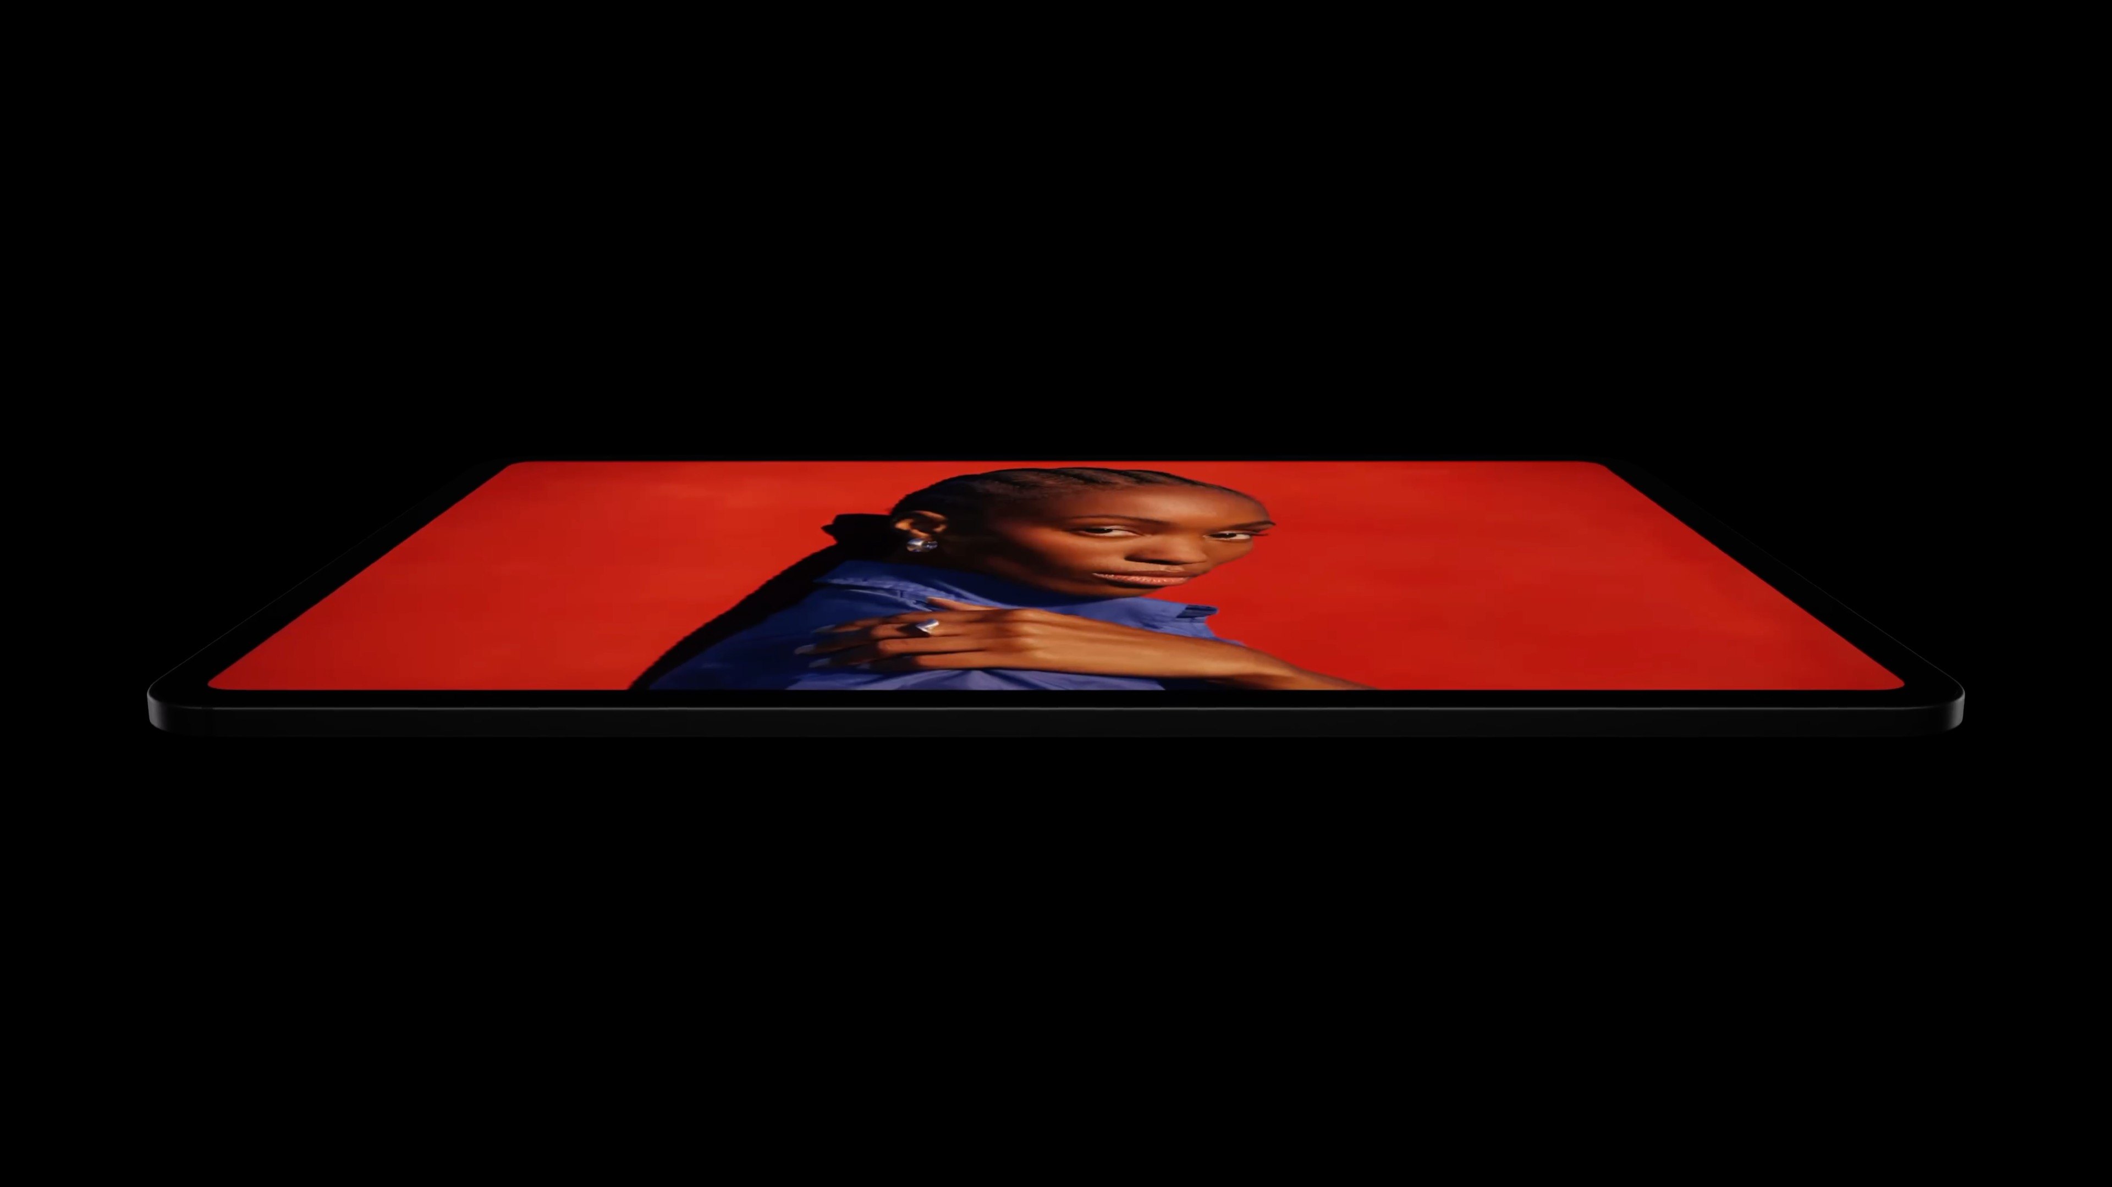

Slide 72
Tandem OLED design
Extreme brightness
Precise contrast
P3 wide color
Wide viewing angle
Nano-texture glass option

Slide 73
The World‘s most
advanced display

Slide 74
Apple silicon

Slide 76


Slide 77
Second-generation
3 nm technology

Slide 78
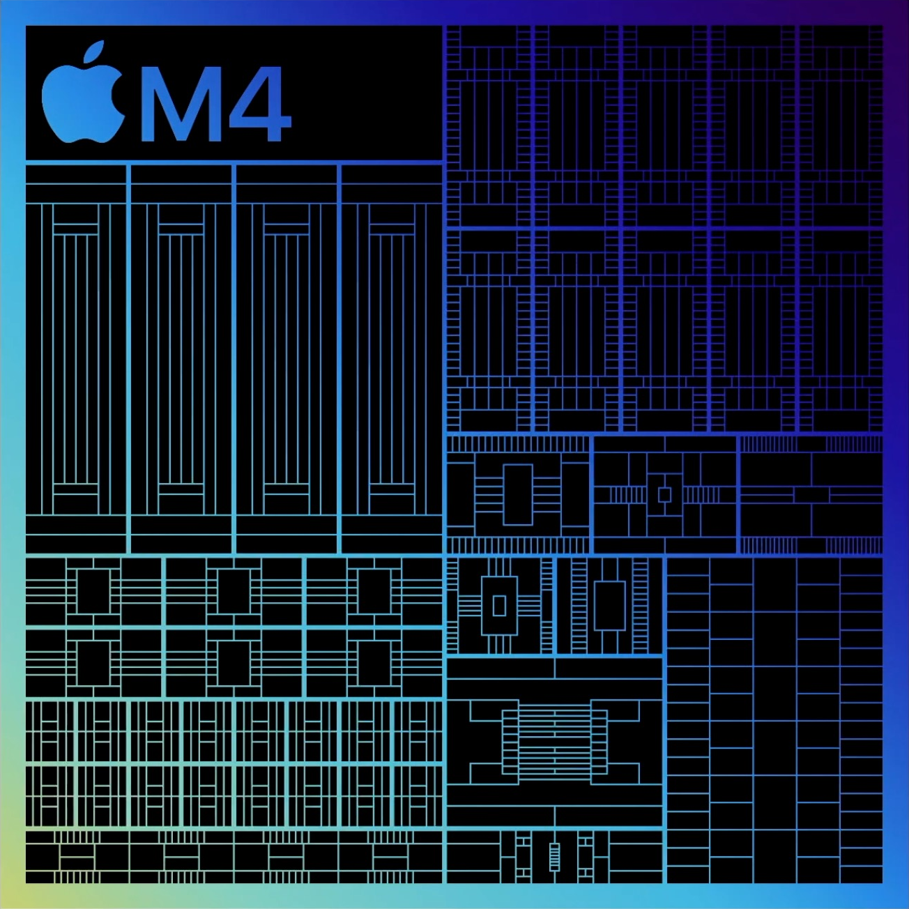
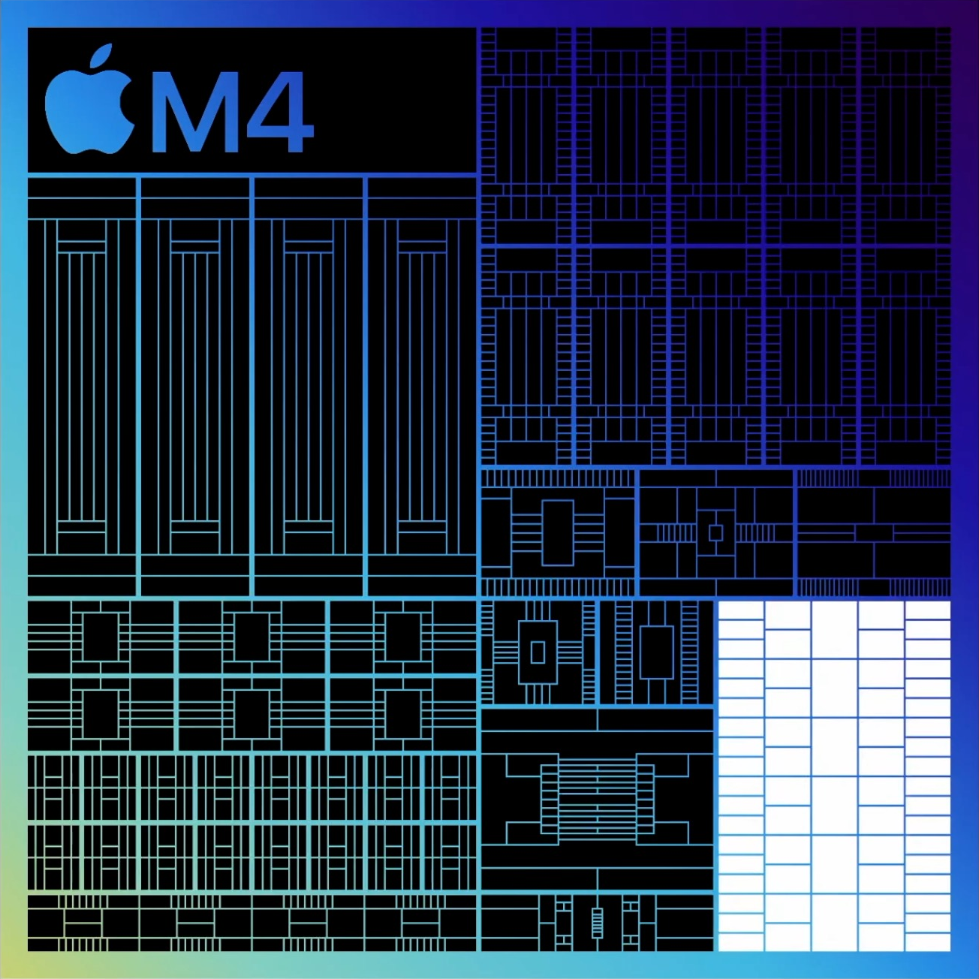
Display engine
Tandem OLED support
Brightness and color compensation
10Hz-120Hz Promotion support

Slide 79
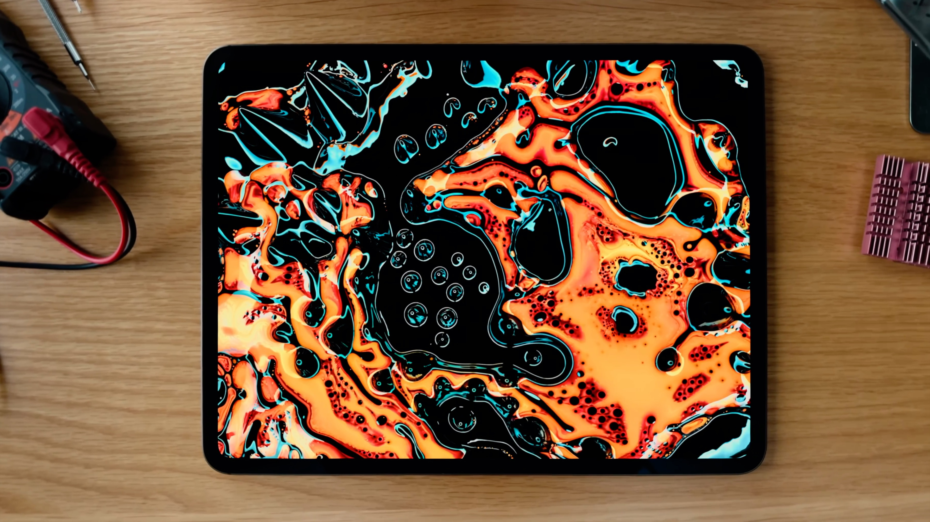

Slide 80
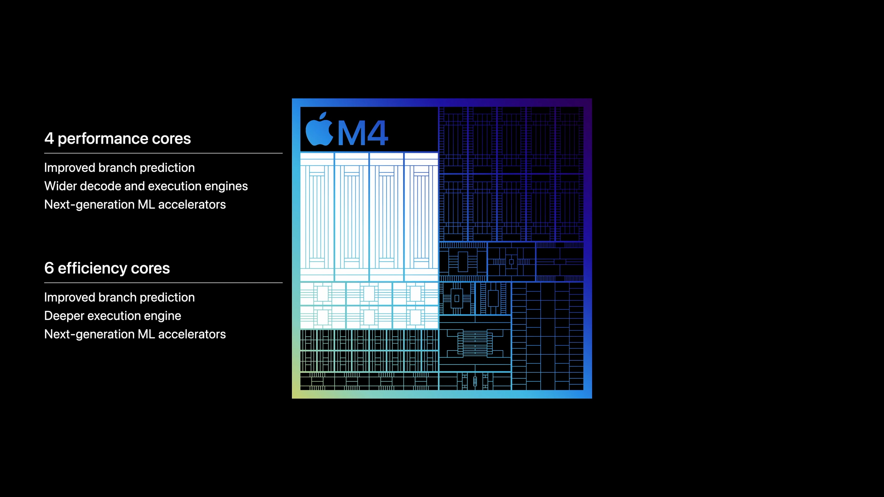
4 performance cores
Improved branch prediction
Wider decode and execution engines
Next-generation ML accelerators
6 efficiency cores
Improved branch prediction
Deeper execution engine
Next-generation ML accelerators

Slide 81
50%
Faster CPU performance than M2

Slide 82
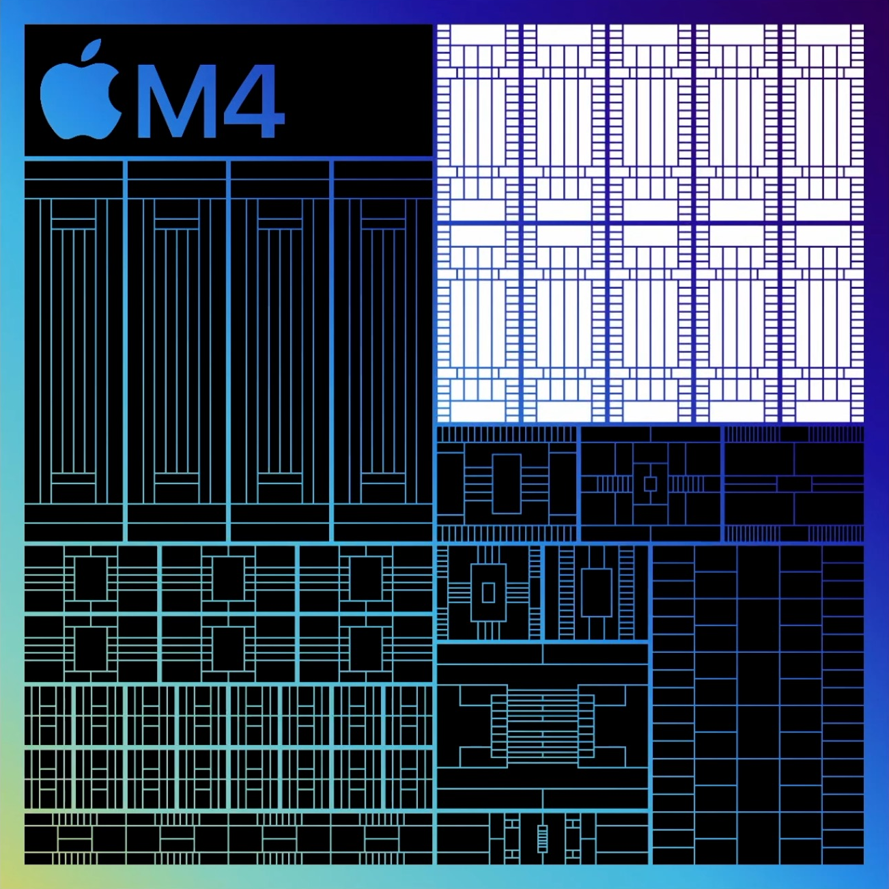
10-core GPU
Next-generation architecture
Dynamic Caching
Mesh shading
Ray tracing

Slide 83
4x
Faster pro rendering performance than M2

Slide 84
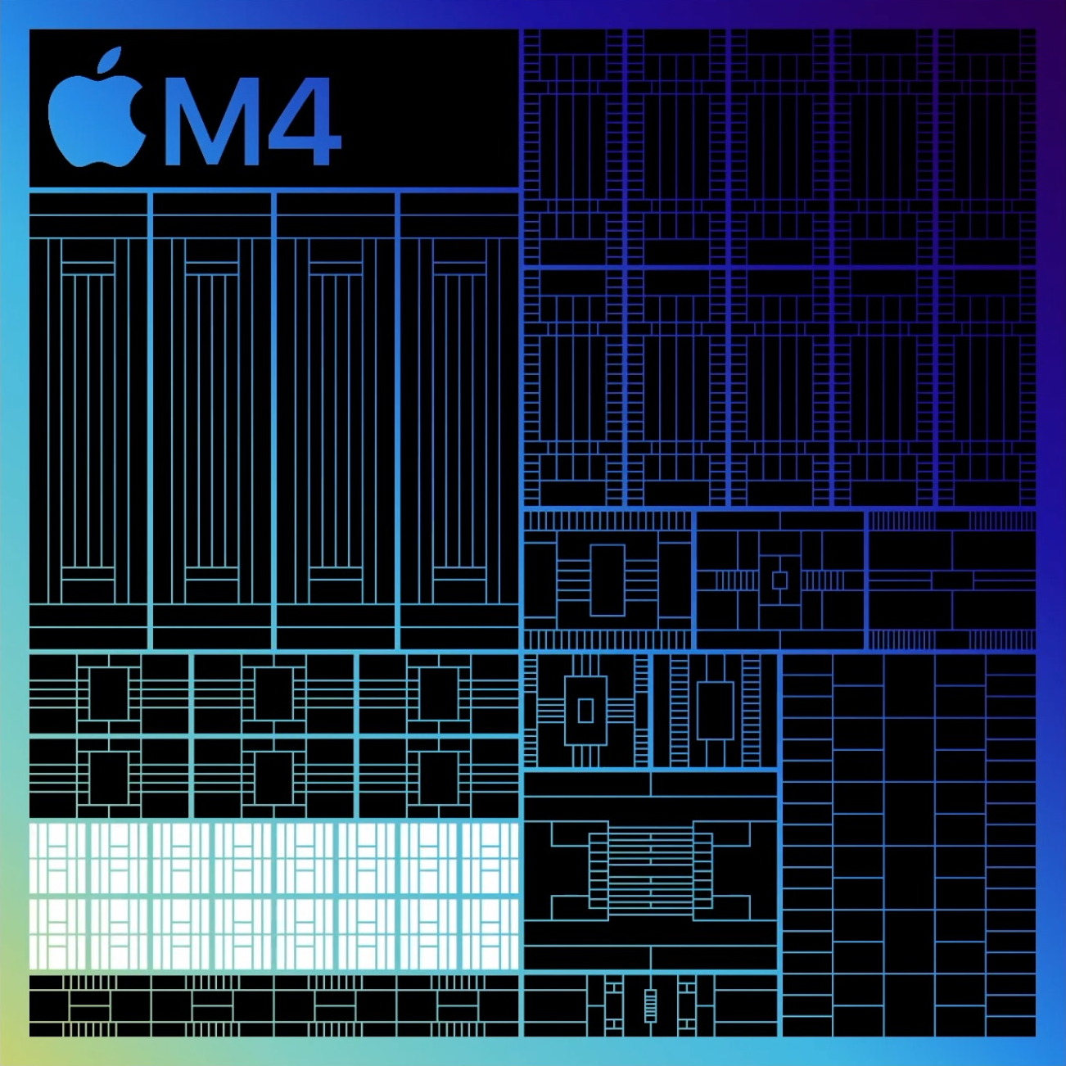
Neural Engine
16-core design
Faster and more efficient

Slide 85
38 trillion
Neural Engine
16-core design
Faster and more efficient
Operations per second

Slide 86
60x
Faster than first Neural Engine

Slide 87
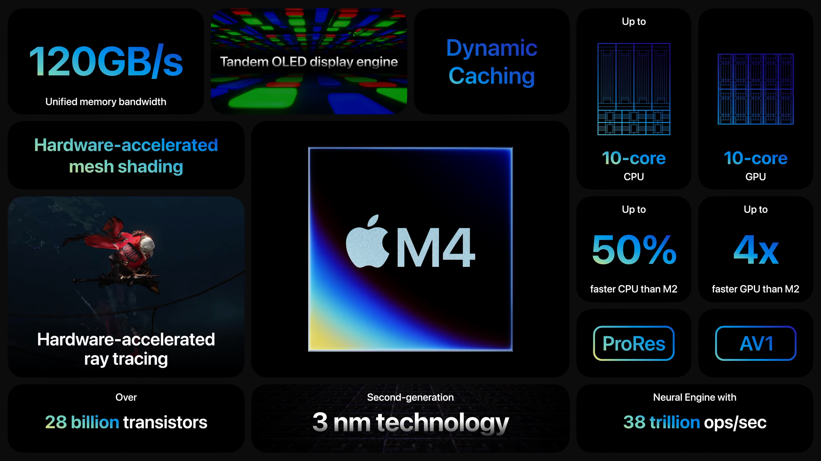
Notes:
该页的动画处理请参考 iPad air 总结页面。

Slide 89
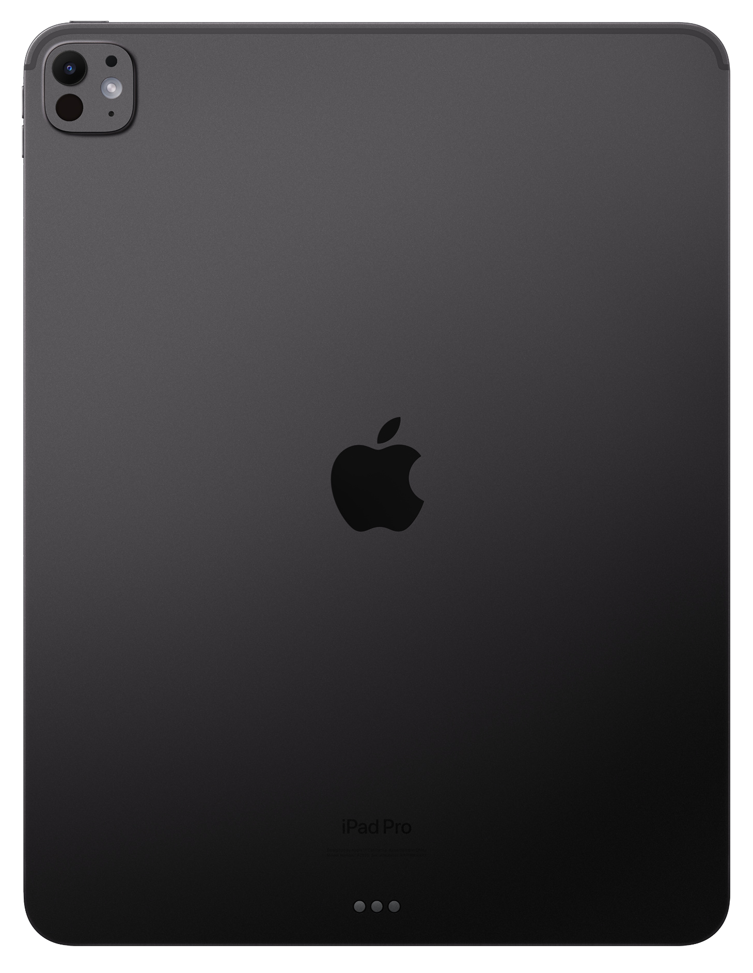

Slide 91
20%
Improved thermal performance

Slide 92
4x
Faster than iPad Pro with M2

Slide 93
10x
Faster than original iPad Pro

Slide 94
iPadOS

Slide 95
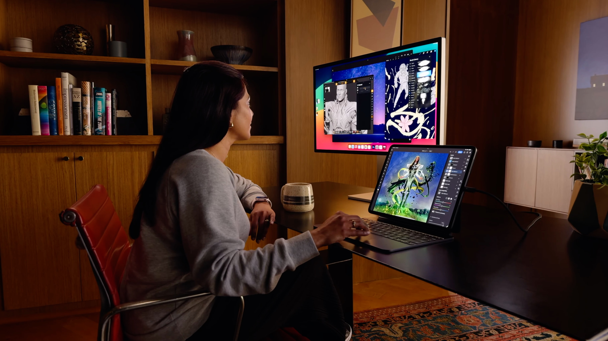

Slide 96

Core ML

Slide 97
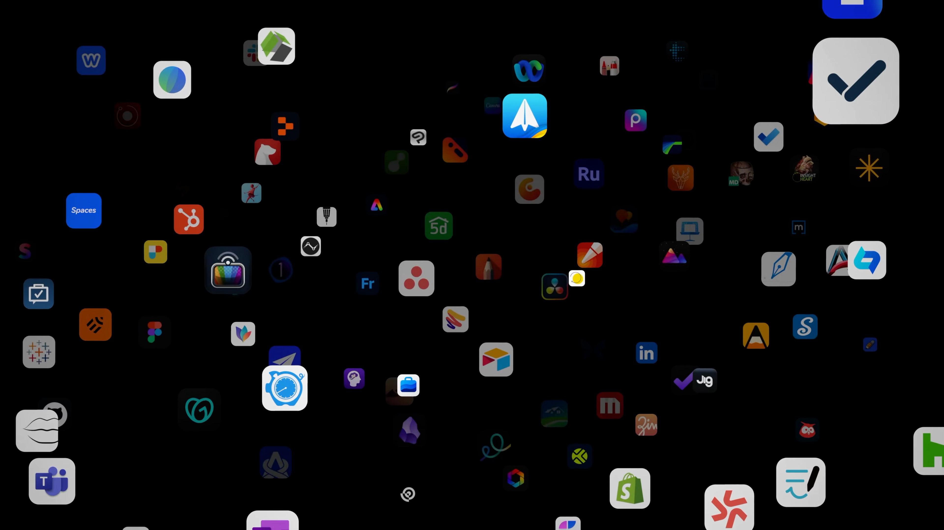

Slide 98
Pro apps

Slide 99
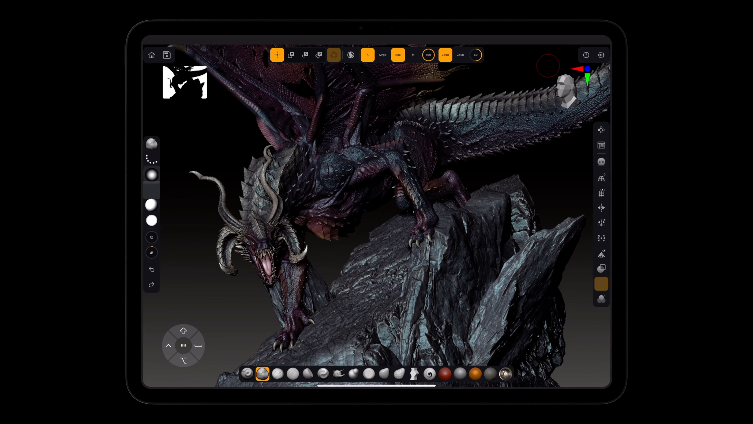

Slide 100
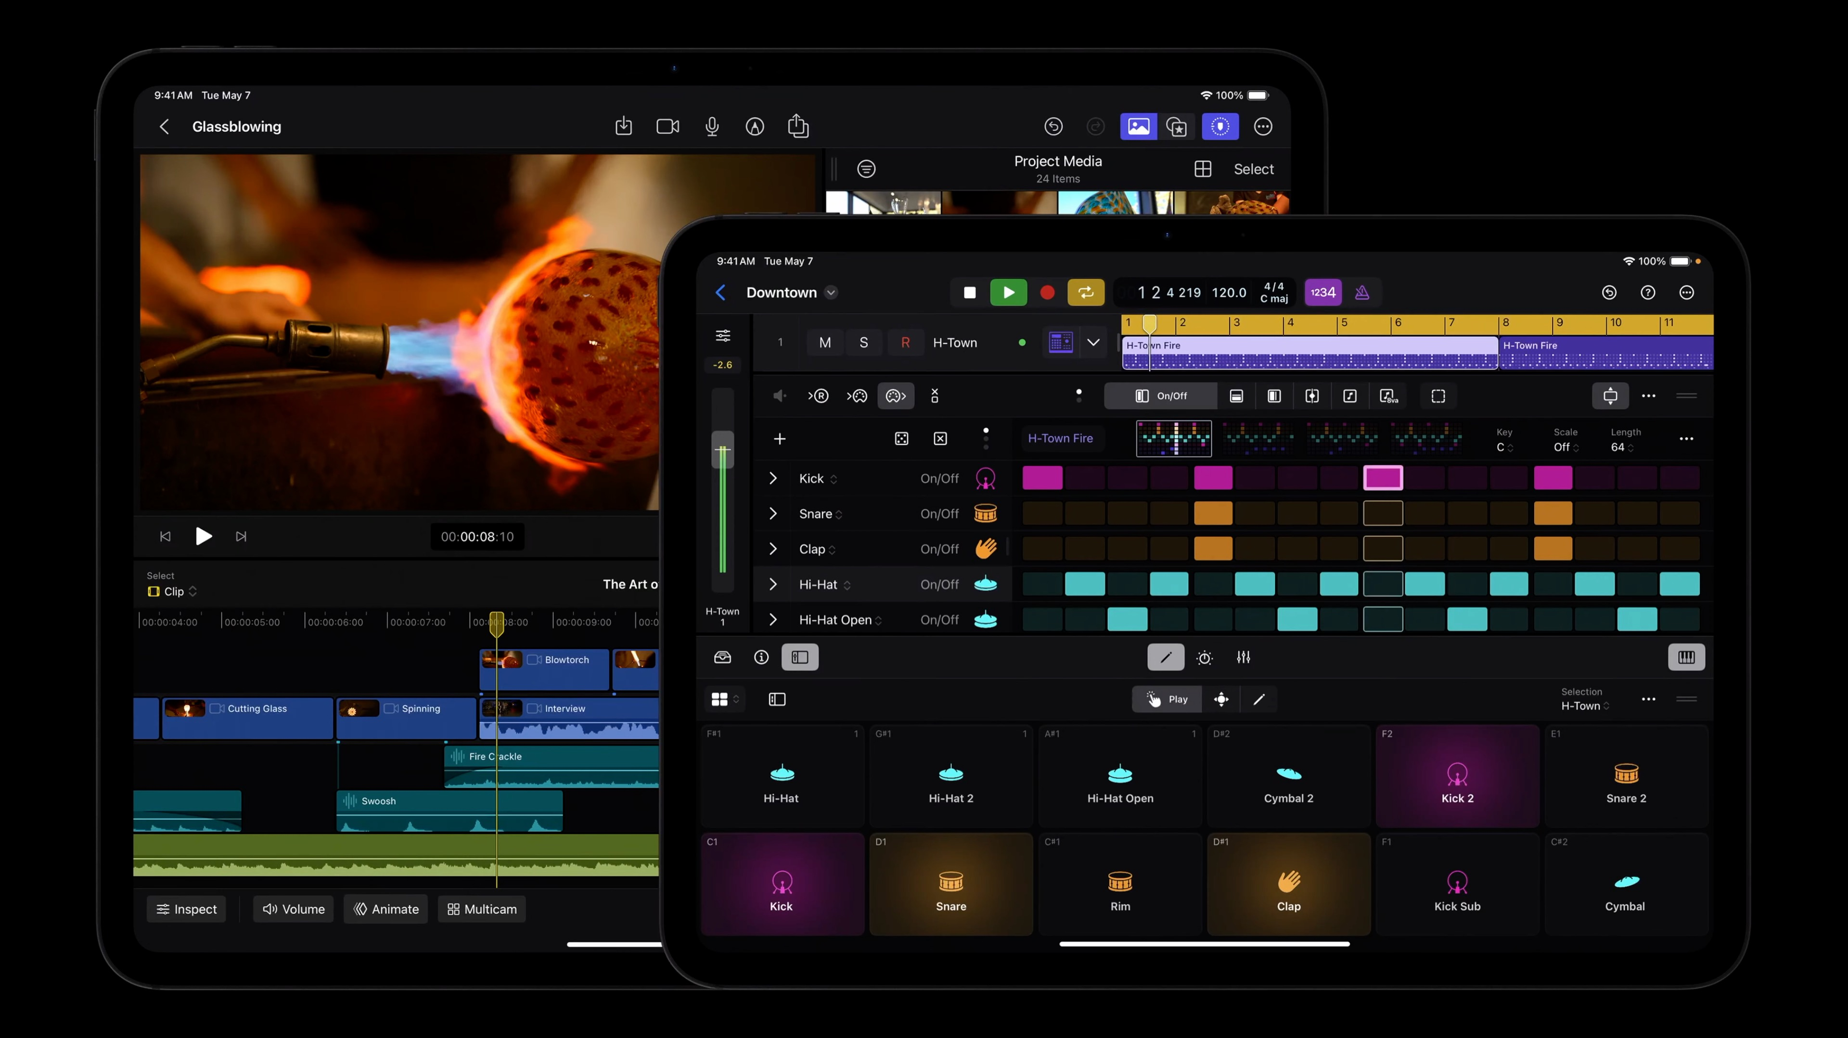

Slide 101



Slide 102
2x
Faster final rendering

Slide 103
Live Multicam

Slide 104
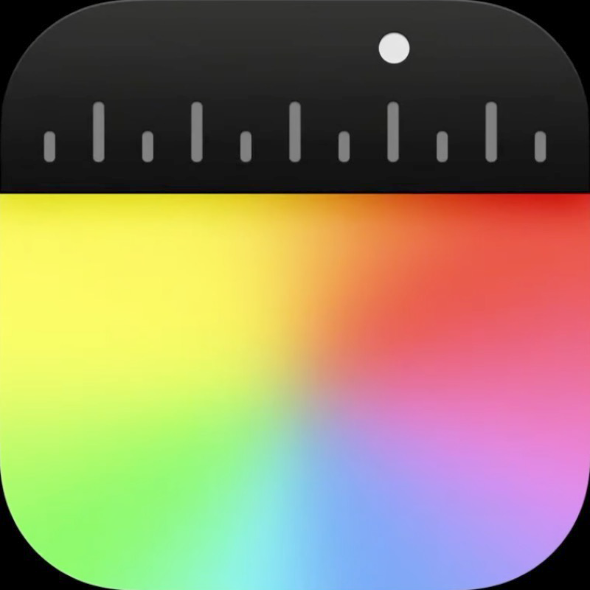
Final Cut Camera

Slide 105
4x
More streams of ProRes RAW

Slide 107
Cameras

Slide 108
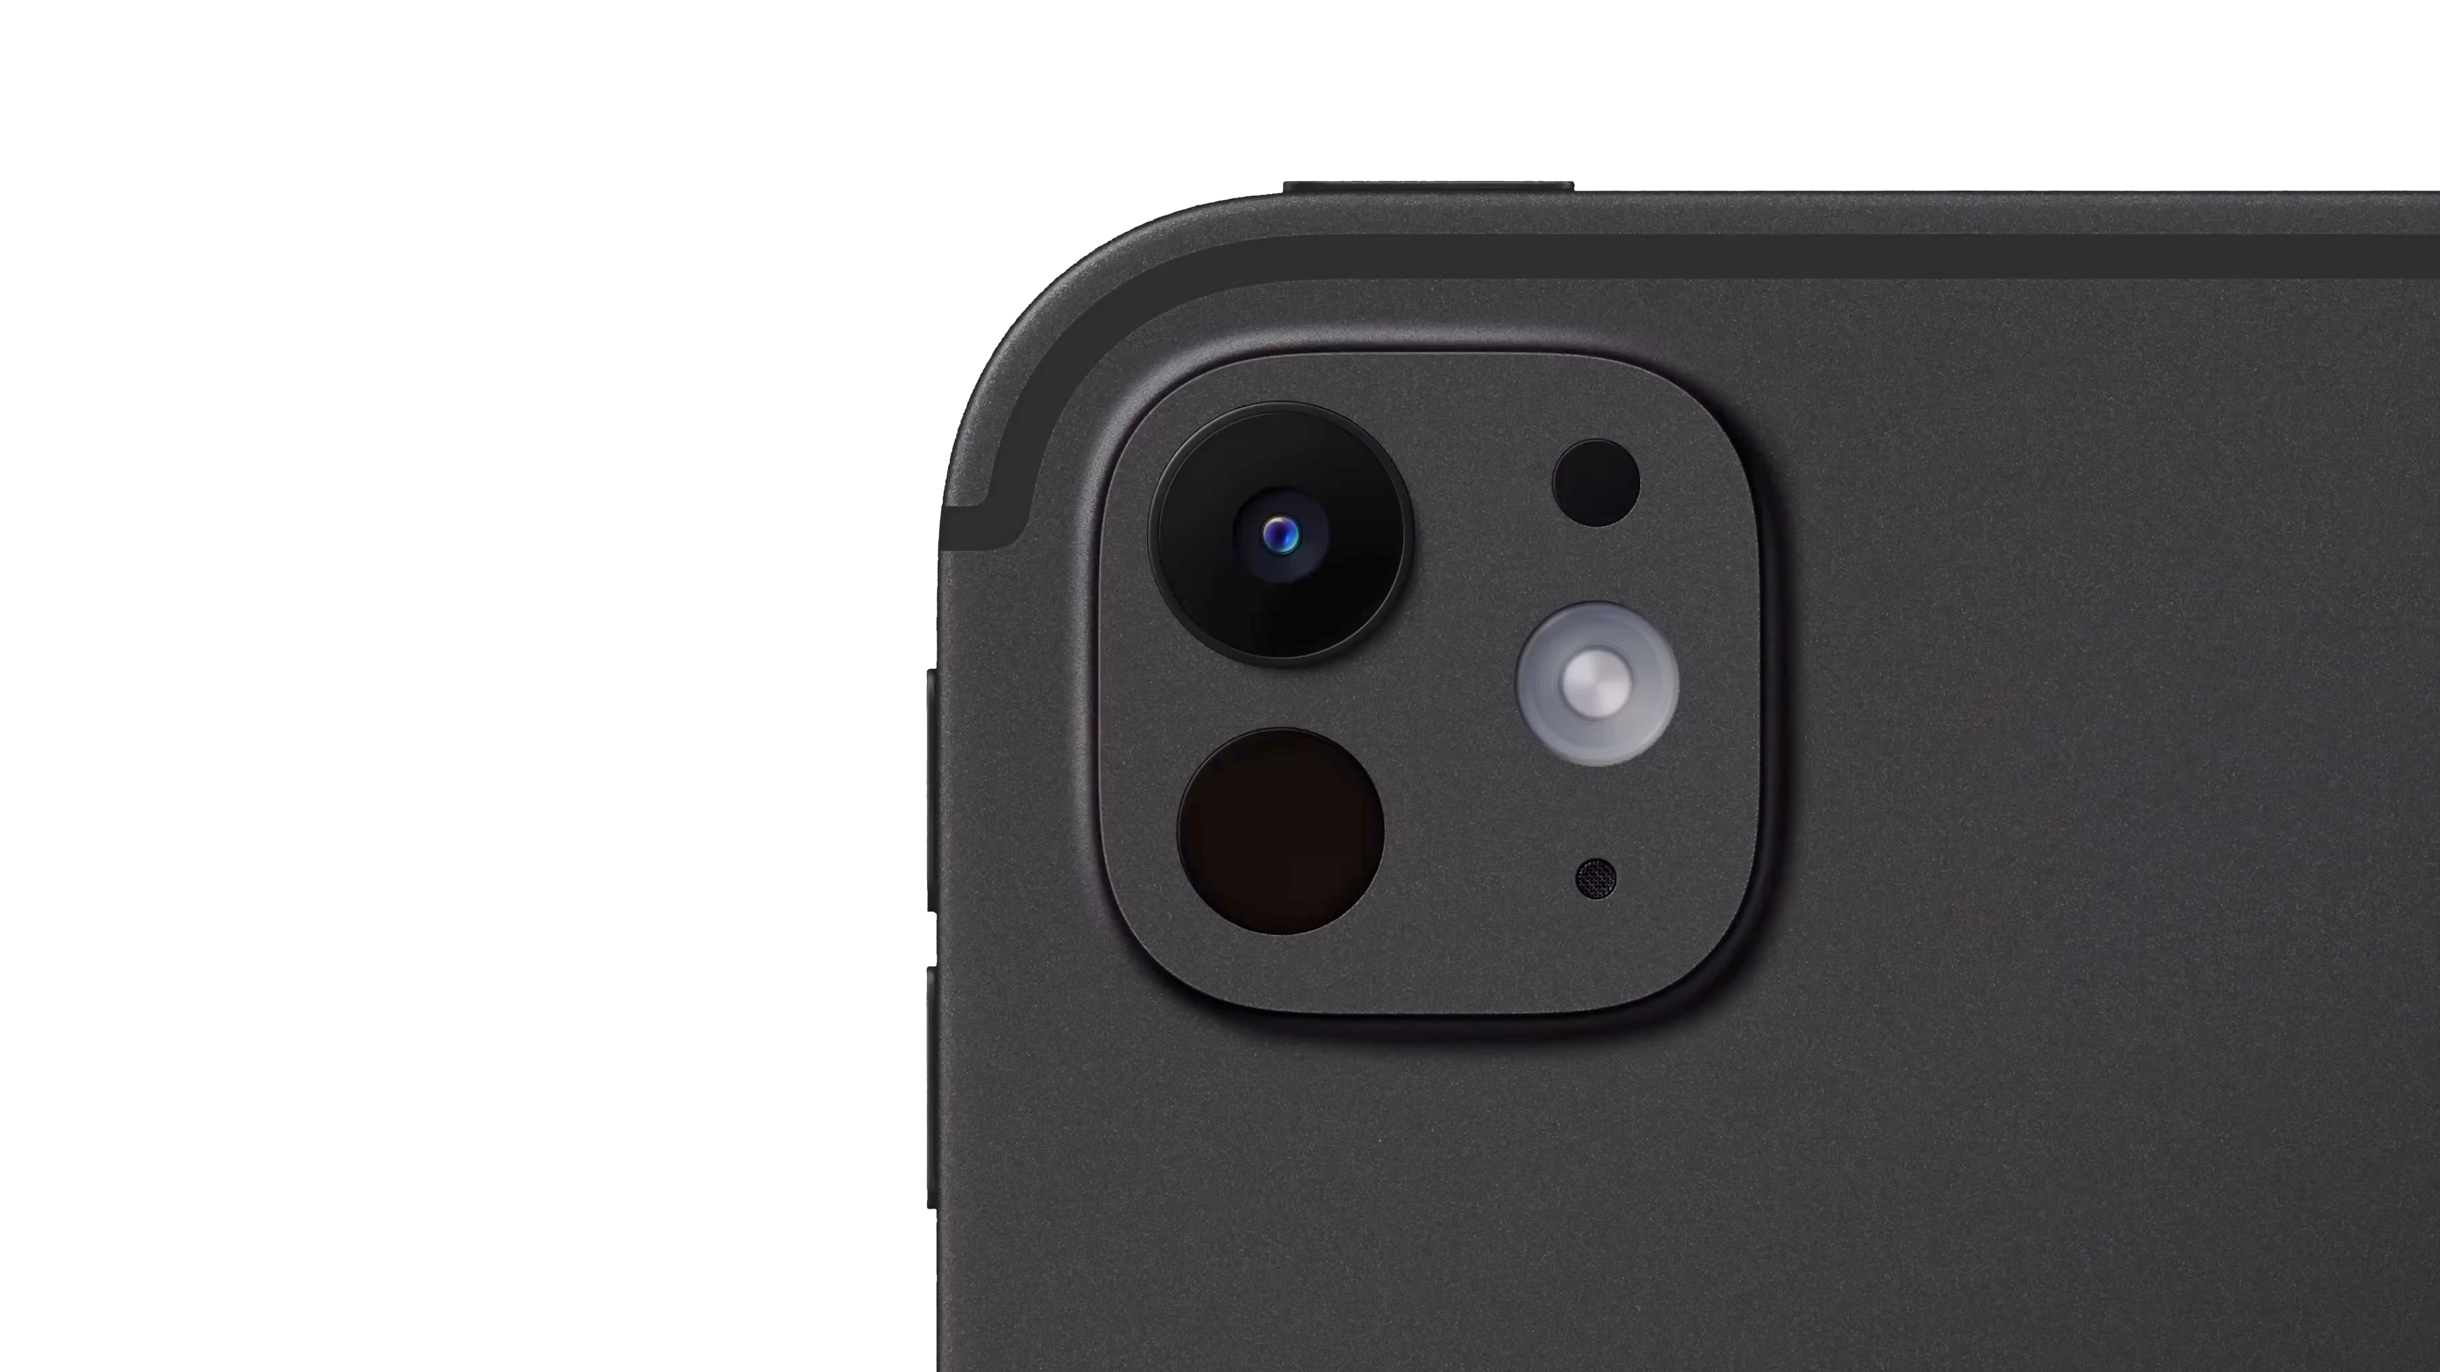
12MP camera
ƒ/1.8 aperture
Five-element lens
Smart HDR 4
4K ProRes video

Slide 109
LiDAR Scanner

Slide 110
Adaptive True Tone flash

Slide 111
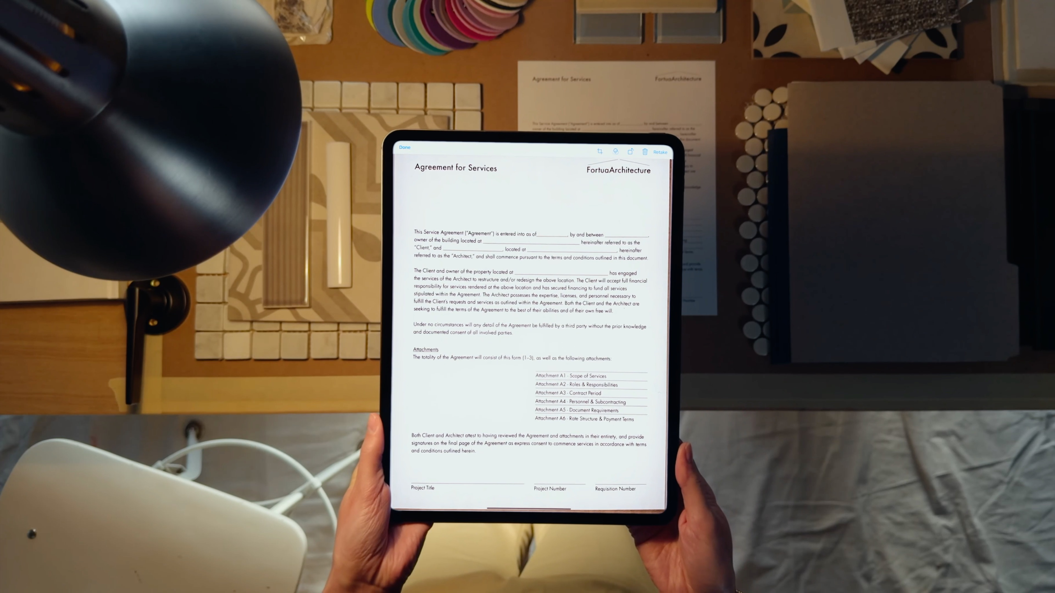

Slide 112




Slide 114
Magic Keyboard

Slide 115


Slide 116
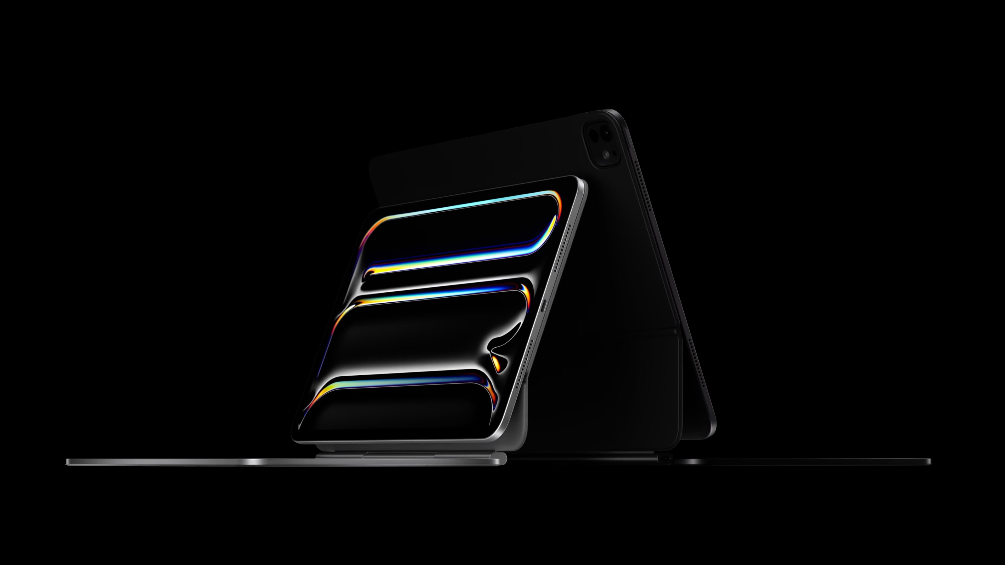

Slide 117
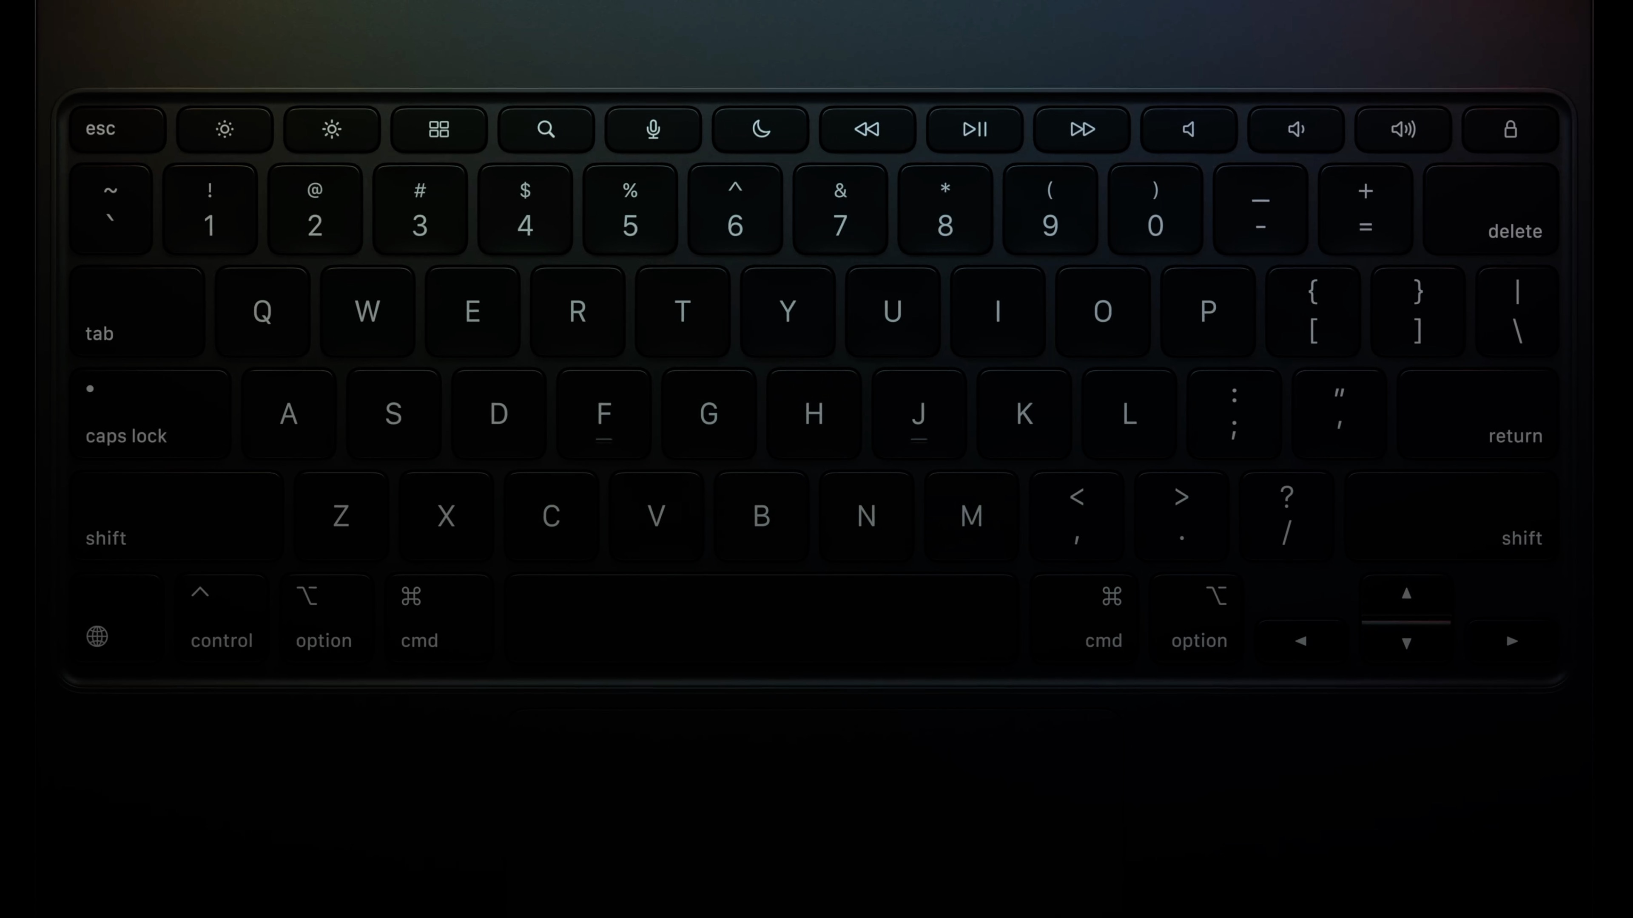

Slide 118
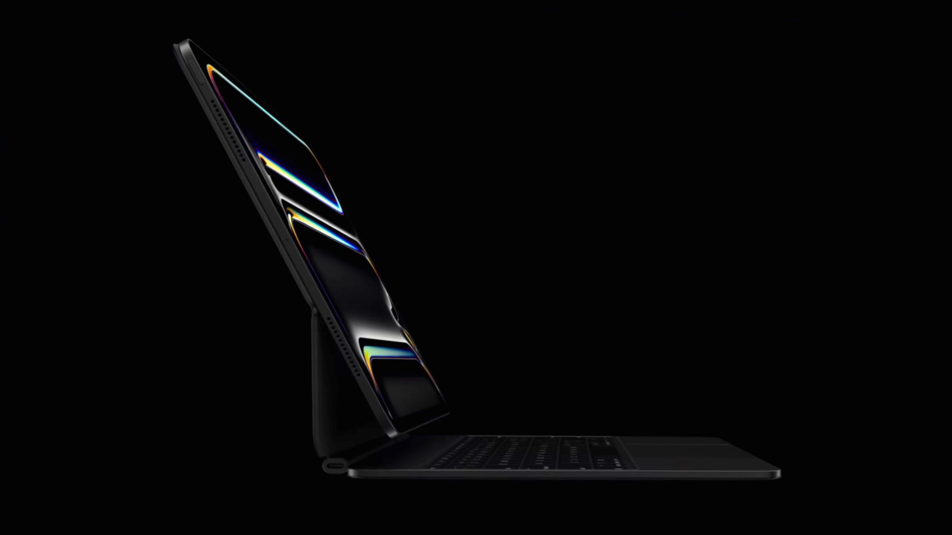

Slide 119
Apple Pencil

Slide 120
Low latency
Pixel-perfect precision
Double tap
Pressure sensitivity
Apple Pencil hover

Slide 121


Slide 122
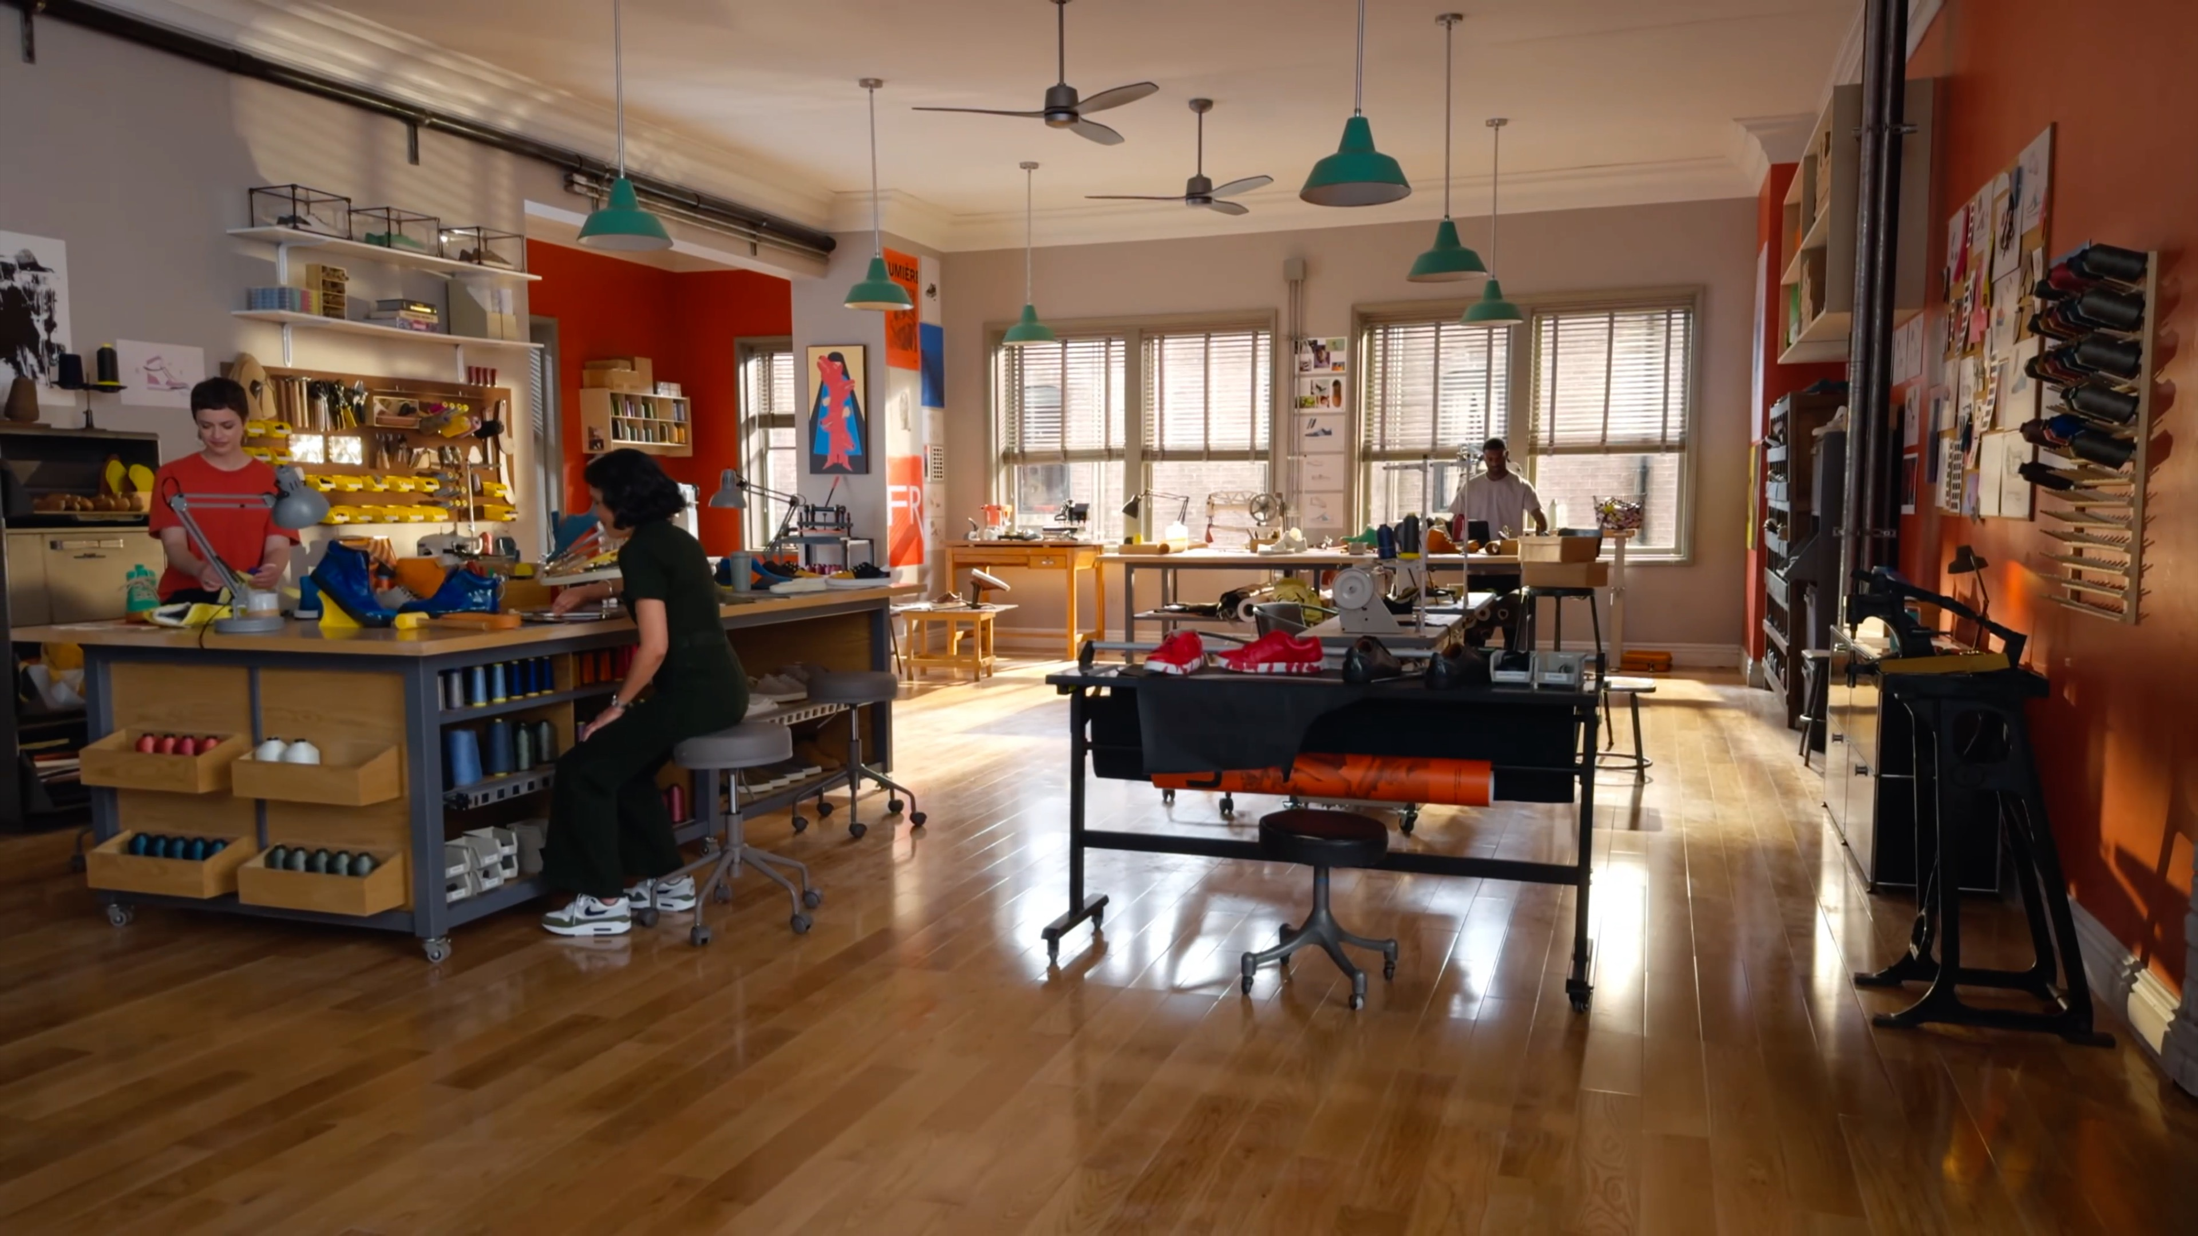

Slide 123
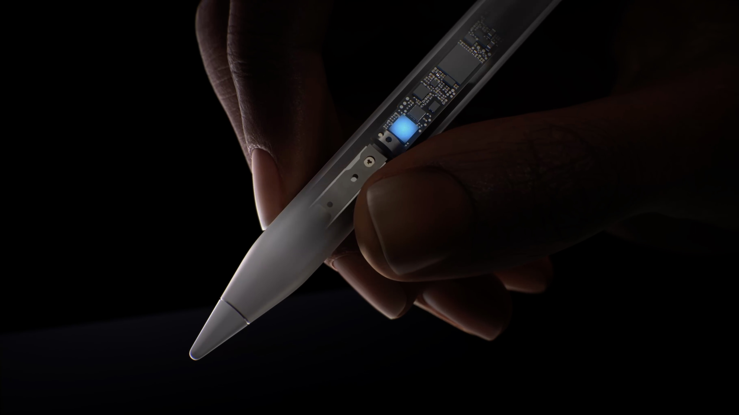

Slide 124


Slide 125


Slide 126
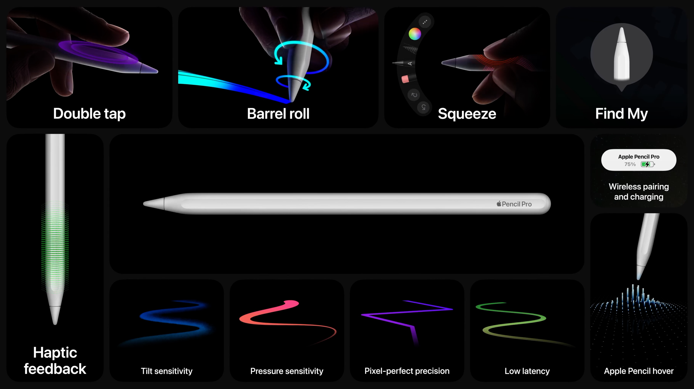
Notes:
该页的动画处理请参考 iPad air 总结页面。

Slide 127
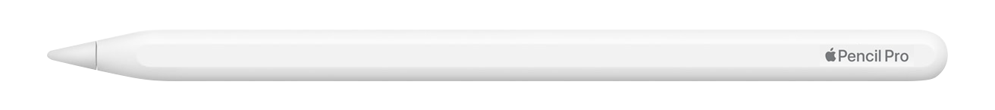

Slide 128


Slide 129
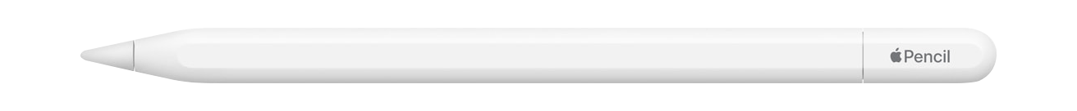

Slide 131
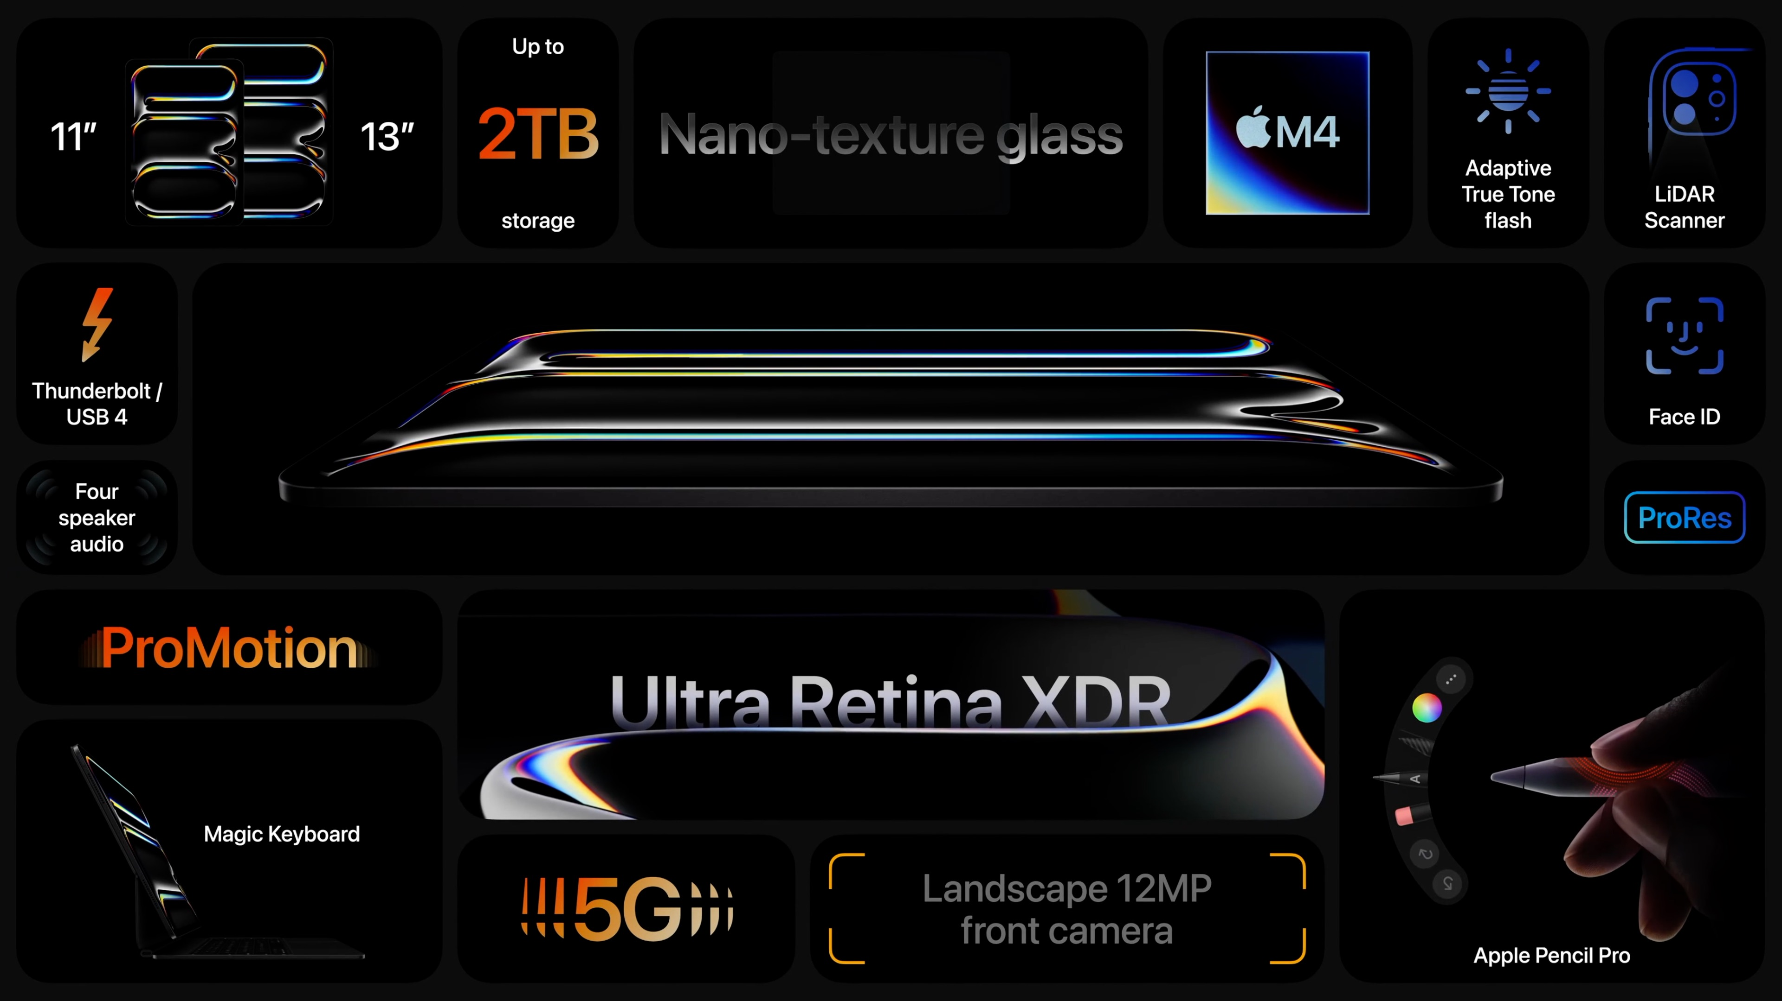
Notes:
该页的动画处理请参考 iPad air 总结页面。

Slide 132
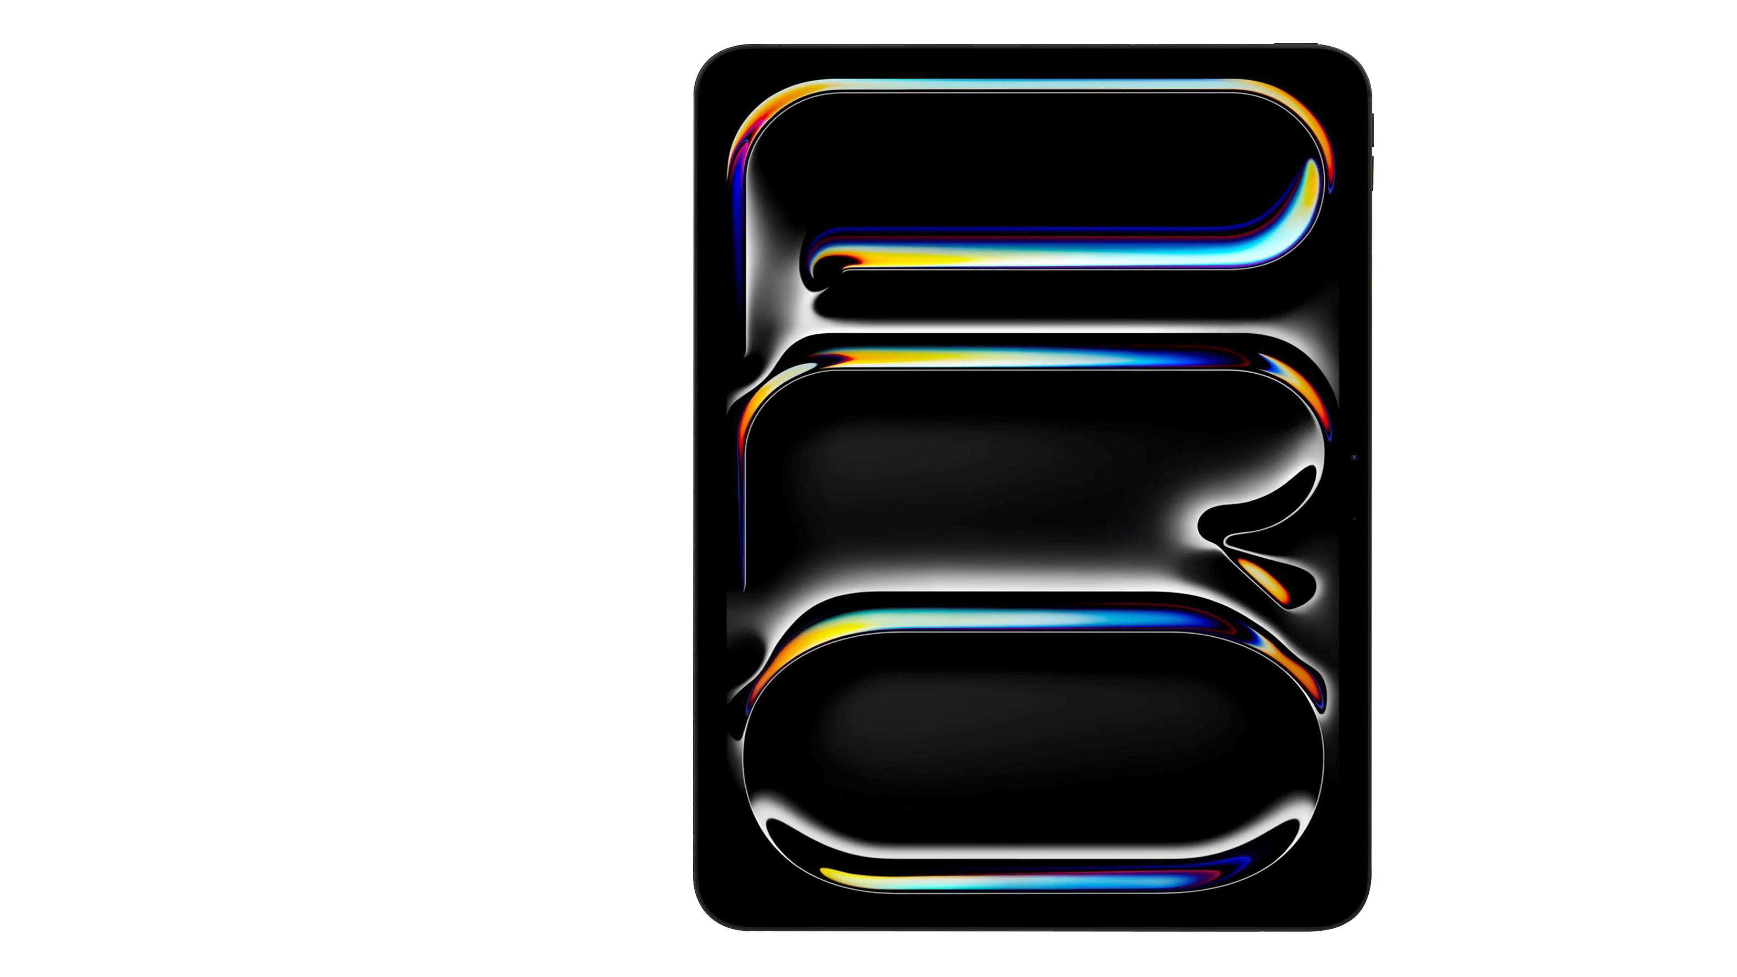
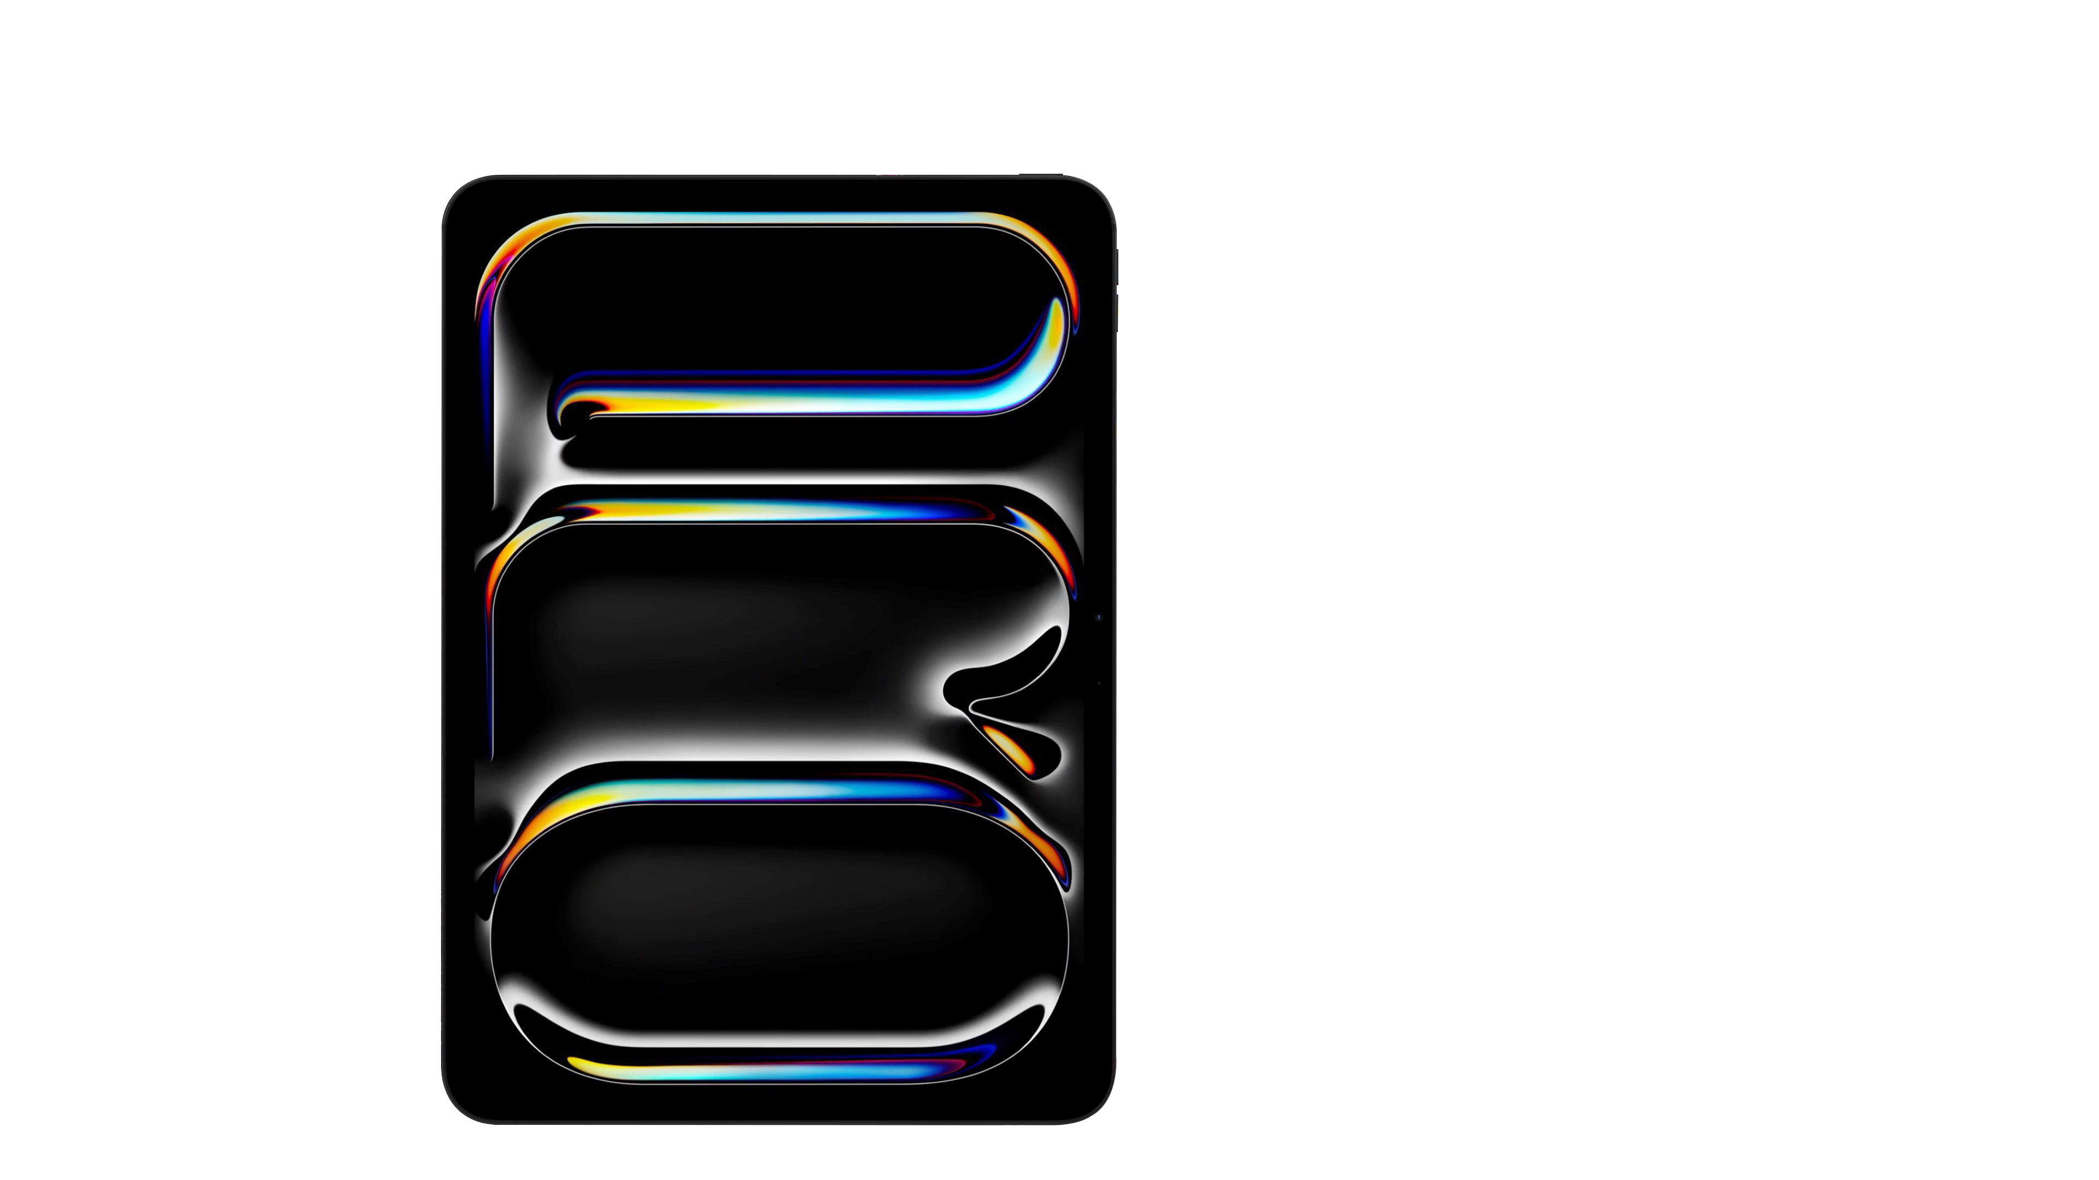
iPad Pro
256GB

Slide 133
iPad Pro
512GB
256GB
1TB
2TB

Slide 134
iPad Pro
From
From
$999
$1299
11-inch
13-inch

Slide 135
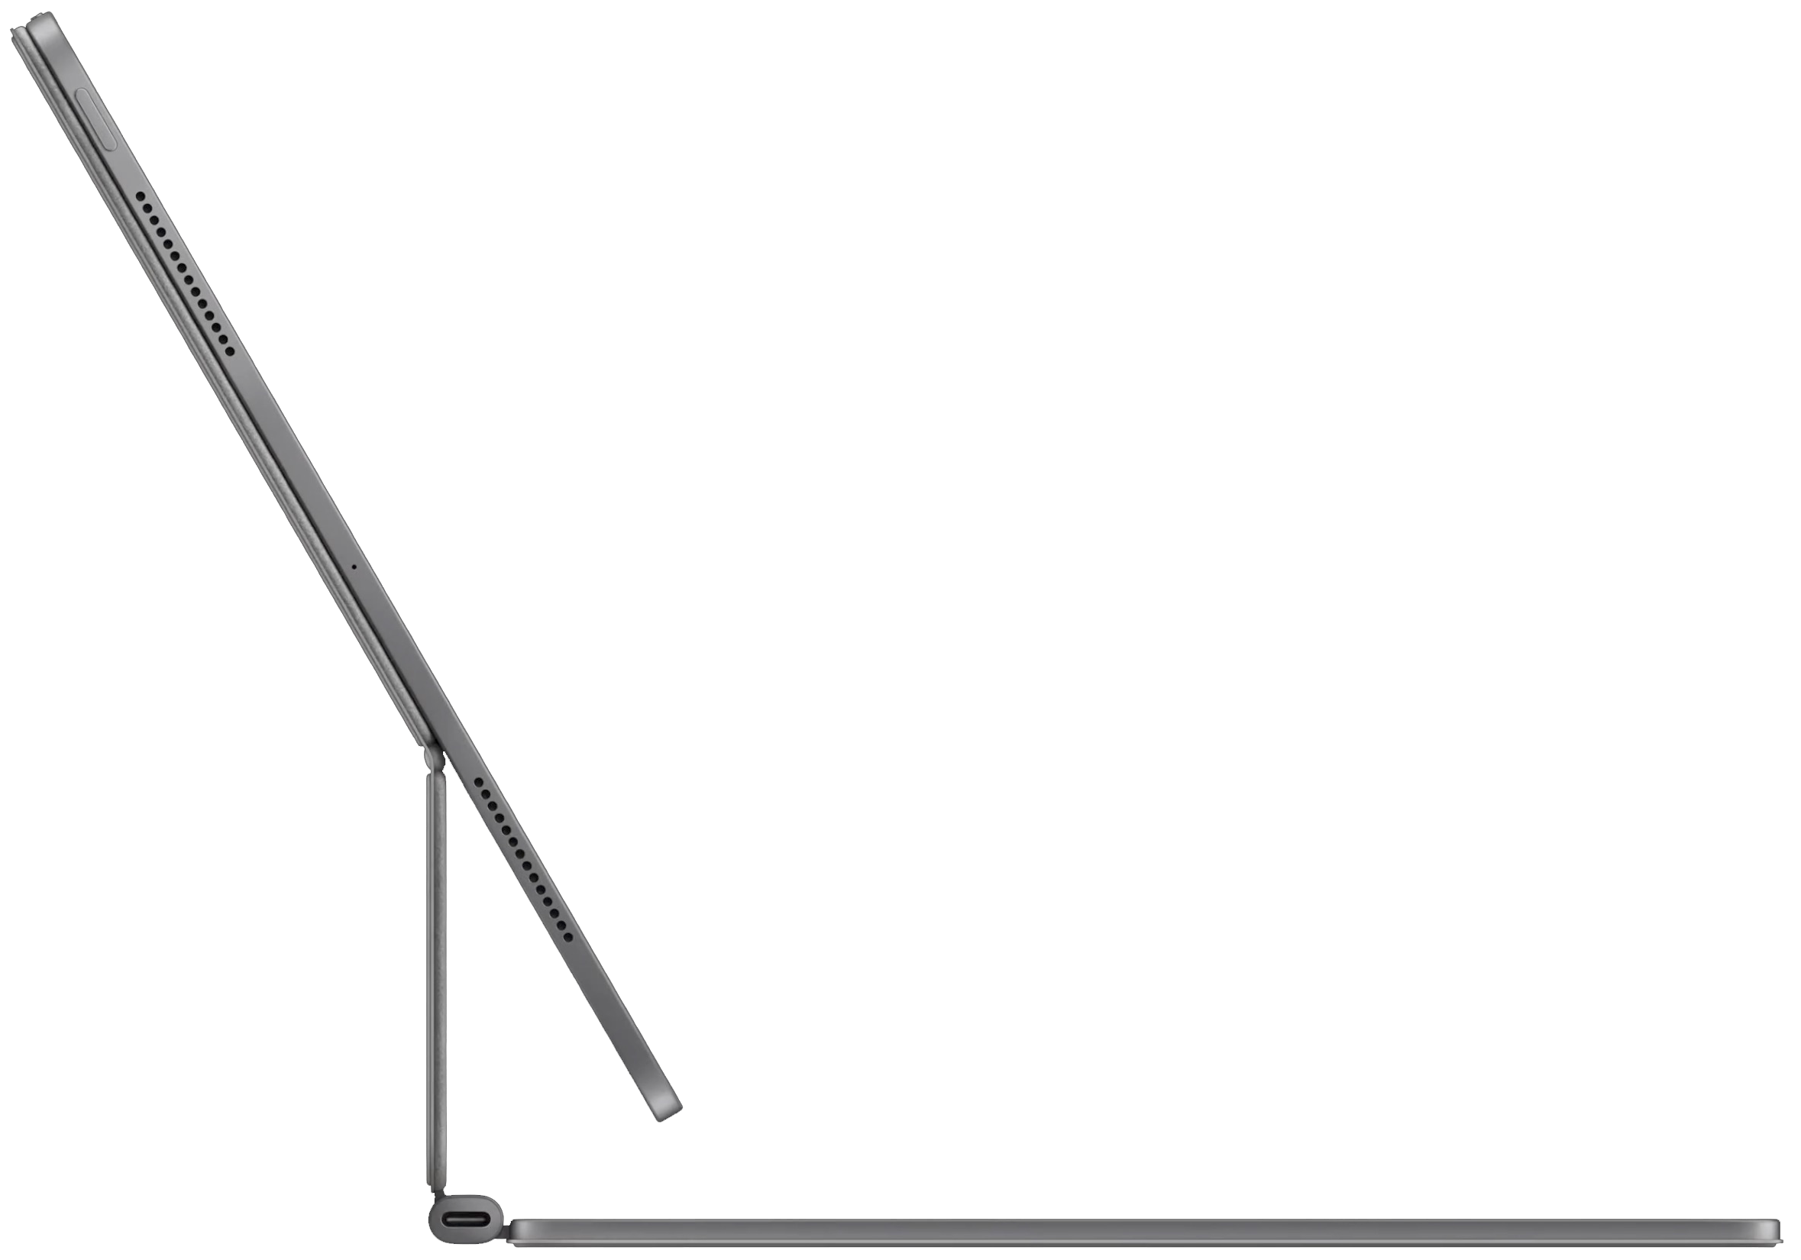
Magic Keyboard
11-inch
13-inch
$299
$349

Slide 136
Apple Pencil Pro
$129

Slide 137
Apple Pencil Pro
$129

Slide 138

Order
Today

Slide 139
Available
Next week

Slide 140

iPad
From
$349

Slide 141


Slide 142


Slide 146


Slide 147


